Slide 1
Introduction to RNA-seq
Dr Pieta Schofield

Slide 2
RNA-Seq Motivation
“Living systems are dynamic and complex, and their behavior may be hard to predict from the properties of individual parts.”
(Website of the Department of Systems Biology, Harvard Medical School)

Slide 3
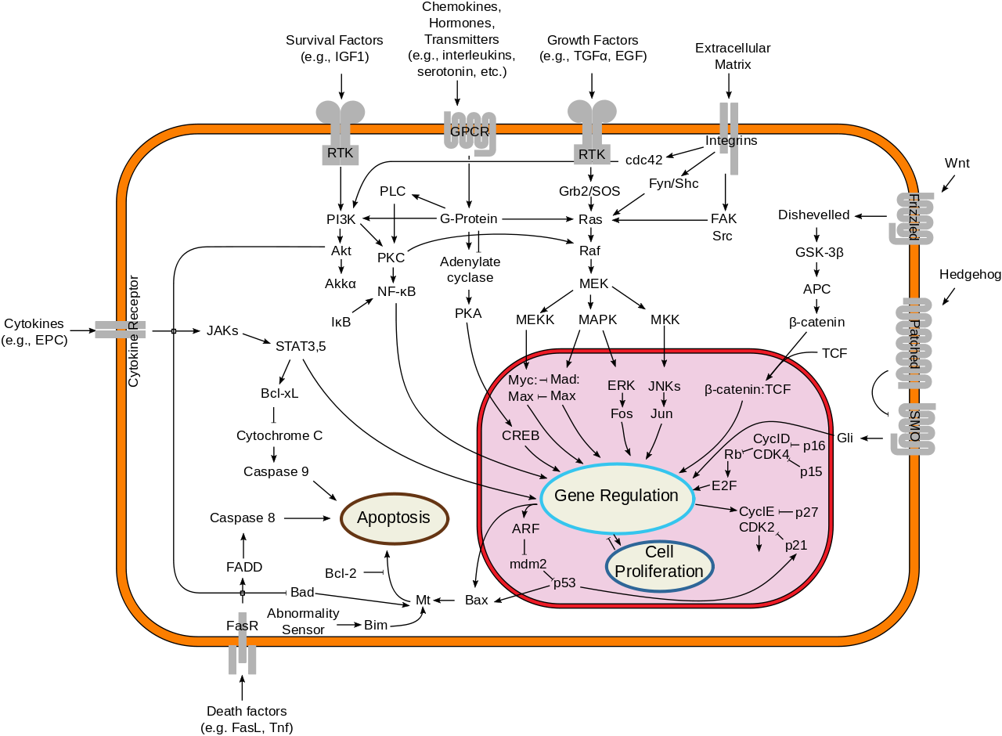
Systems biology aims to understand complete pathways/networks of interactions of biological molecule, and how they will react when manipulated
Image http://en.wikipedia.org/wiki/File:Signal_transduction_v1.png

Slide 4
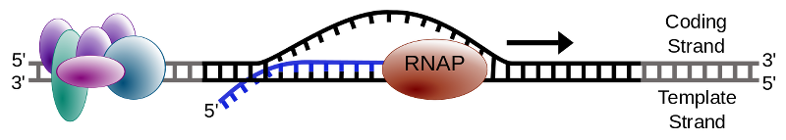
genetic DNA -> transcribed to RNA (transcripts)
RNA-seq is an application of high throughput sequencing that attempts to analyse what composition of RNA molecules is present in a sample
Image Wikipedia
Notes:
DNA is generally considered to be just the code that stores the information. Generally the molecules that are considered to be active with in a cell are RNA’s and proteins. RNA-seq hopes to use HTS to study what active molecules are present in a particular cell or condition and do it on a whole genome scale.

Slide 5
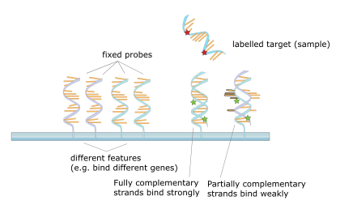
RNA-seq is replacing microarrays
cDNA molecules tagged with fluorophores hybridise to pre-defined array of complementary probes.
Image Wikipedia
Notes:
RNA-seq is gradually replacing microarrays as the technology of choice for doing this. In microarrays RNA was extracted from a sample converted to cDNA and tagged with a fluorescent label, then hybridised to probes fixed to a slide. The amount of fluorescence was taken as a measure for the amount of RNA present in the sample from the region of the genome the probe was from. It was limited because you had to know what you were looking for and design the chip to have those probes on.

Slide 6
Whole transcriptome
  but can be targeted at specific regions
Disadvantages of microarrays
  probes decided on in advance, can only detect what you look for
  complicated normalisation required to account for within and between array technical variation
Perceived advantages of RNA-seq
  probe free, whole transcriptome discovery
  "simpler" more direct measure of transcripts counts
  novel organisms with no existing arrays
Notes:
RNA-seq attempts to be a better alternative, As we will see later the normalisation issue is not really much simpler.

Slide 7
Transcriptome Assembly
  Identify the sequences of the RNA’s in the sample
    Identify rare non-canonical transcripts alternate splicing
  Quantify relative amounts of these transcripts
Differential expression
  Identify which gene/transcript change between different conditions
SNP and splice variant detection.
Notes:
RNA-seq can be used for several applications.

Slide 8
Library prep
Sequencing
RNA-seq Data
Generic Analysis
fastq files
Quality
Control
fastq files
Transcript Assembly
Third Party
Curated Reference
Data
fastq files
Alignment
fasta file
Reference
Sequence
bam/sam
SNP variant
calling
Feature
Assignment
gtf/gff files
Reference
Annotation
count matrix
Gene Set/Pathway
Analysis
KEGGdb
GOdb
STRINGdb
etc.
Expression Analysis
Expression
Results
Functional
Reference

Slide 9
RNA-Seq Library Prep
“For measurements to be meaningful, however, they must retain their connection to the theoretical and instrumental context from which they were derived. “
(Houle et. al. 2011 Q. Rev. Biol.)

Slide 10
RNA
~75% of RNA is 18S & 28S ribosomal RNAs (rRNA)
~10% of RNA is transfer RNAs (tRNA)
~2% of RNA is protein coding messenger RNAs mRNA
Remainder is mix of small and long non-coding mirRNA, snoRNA, lncRNA etc.
  (Jackson et. al. FASEB J. 2000)
Notes:
Most of the RNA in a cell is ribosomal RNA (the machine that translates RNA to protein) or transfer RNA the chaperone that carries amino acid residues to the ribosome.

Slide 11
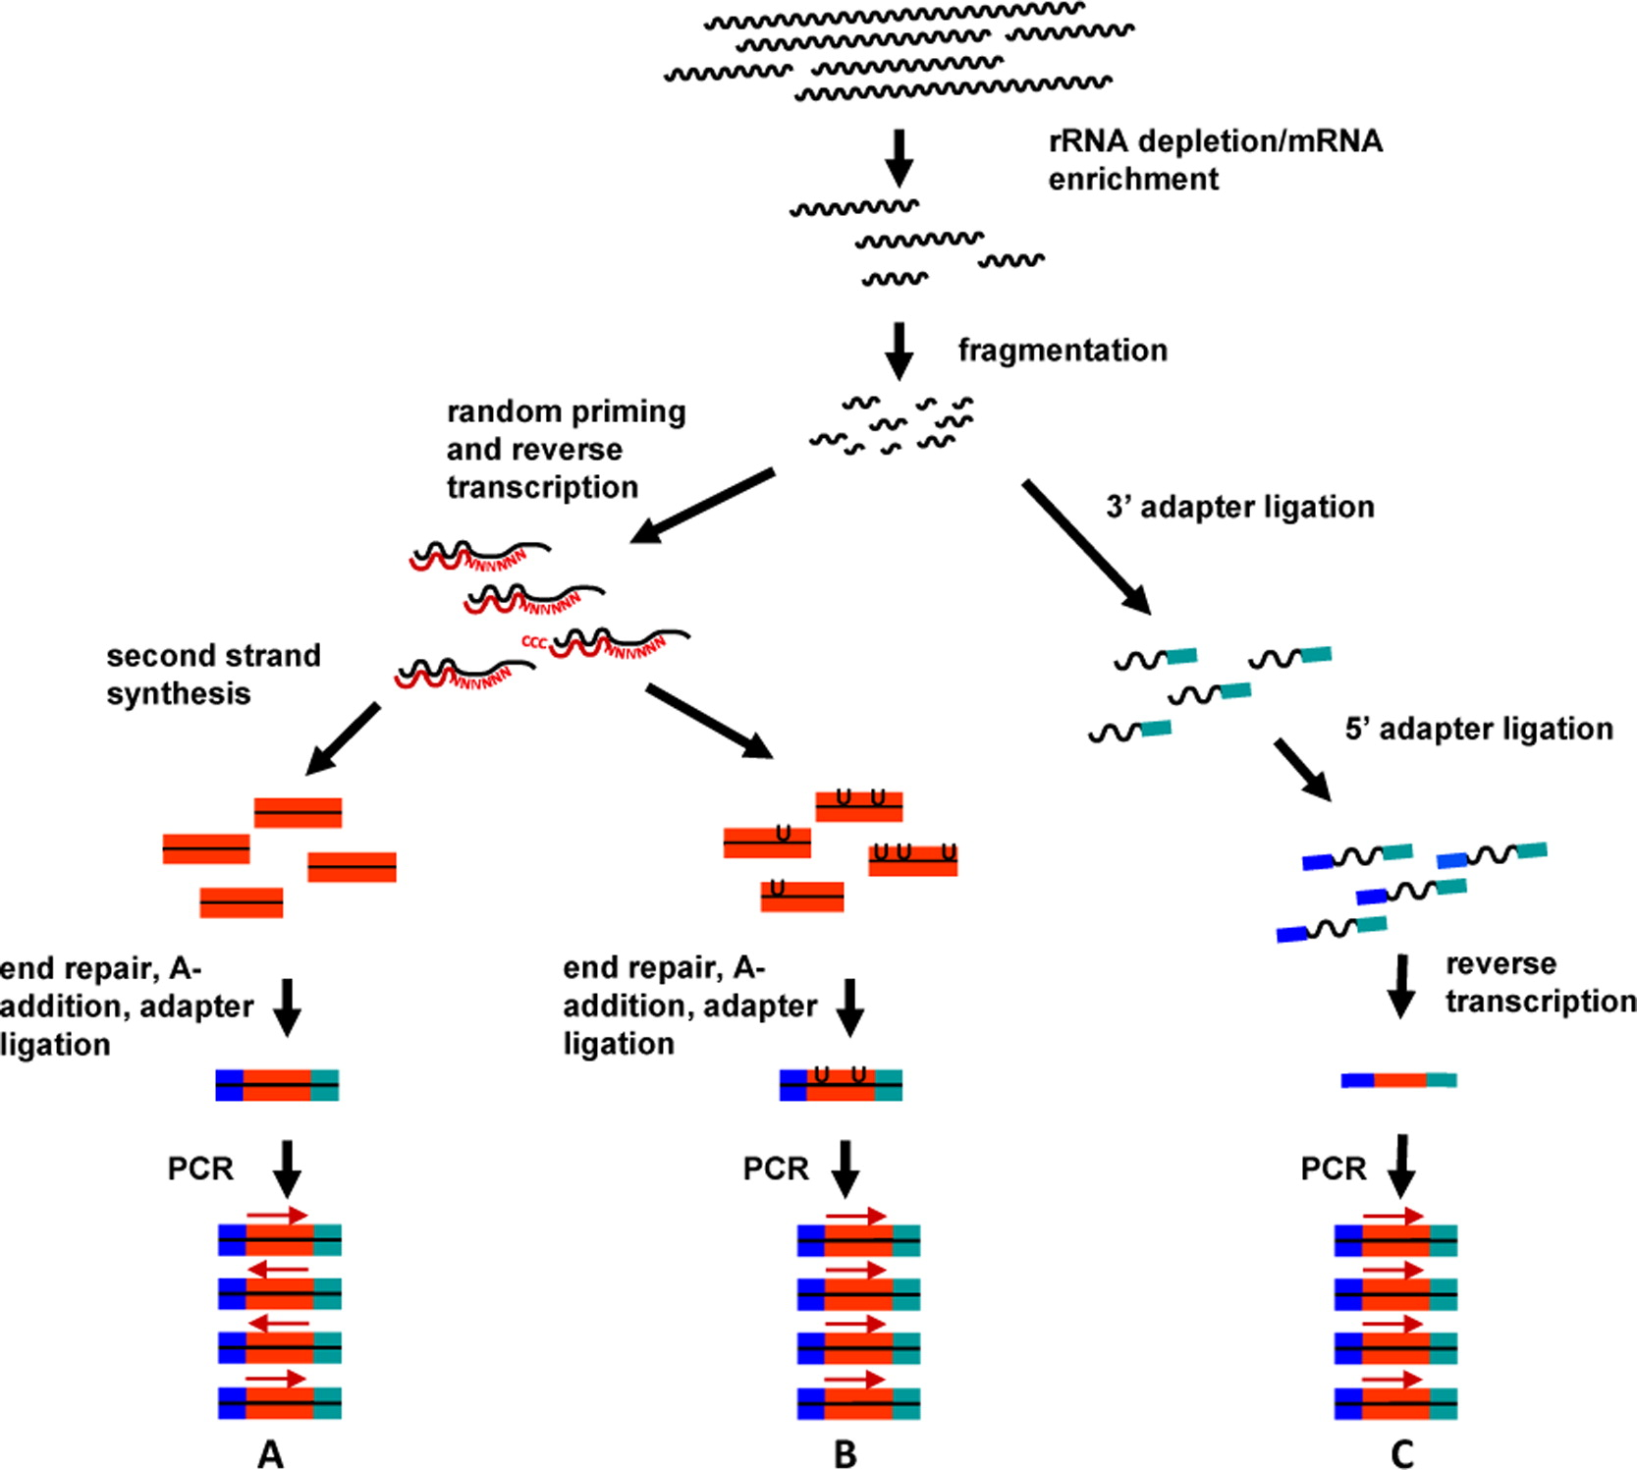
Image van Dijk et. al. (2014) Exp Cell Res
Notes:
To get a signal in the data for the 2-5% of the “interesting” RNA the uninteresting rRNA must be removed first

Slide 12
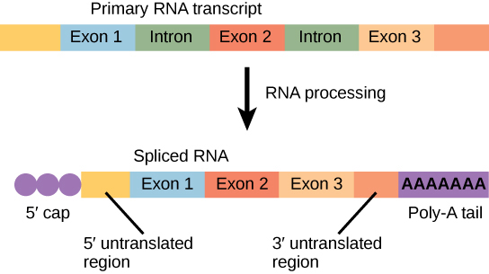
most RNA is processed after/during transcription
mRNA has a 5’cap and a 3’ poly-A tail added
Image https://cnx.org/contents/TkuNUJis@3/Transcription
Notes:
most of the interesting RNA has a polyA tail and a 5’ cap this can be used for pulling the interesting RNA out of the sample. The alternative if you want to have interesting RNA that doesn’t have a polyA tail is to use a ribosomal RNA depletion kit

Slide 13
Enrich for non ribosomal RNA
  polyA pull down
  ribosomal RNA depletion
    ribo-minus, ribo-zero kits
Fragment
  Add primers
Reverse transcribe
  Can produce strand specific cDNA’s
Amplify what is left
  PCR can introduce bias
Then sequence
  more often than not these days with Illumina

Slide 14
Generally however sequencing is not quantitative it is proportional because sample is scale up to a fix volume
Sample A
Sample B
Extracted
Sequenced
Extracted
Sequenced

Slide 15
Add (spike-in) fixed amounts artificial calibration RNA’s
Sample A
Sample B
Extracted
Sequenced
Extracted
Sequenced
External RNA Controls Consortium (ERCC)
Notes:
In an attempt to get some measure of quantitation it is possible to put in a fixed amount of known artificial RNAs called “spike-ins” into the library. The relative proportion of the genetic to the artificial RNA give a measure of how much total genetic RNA was in the mix

Slide 16
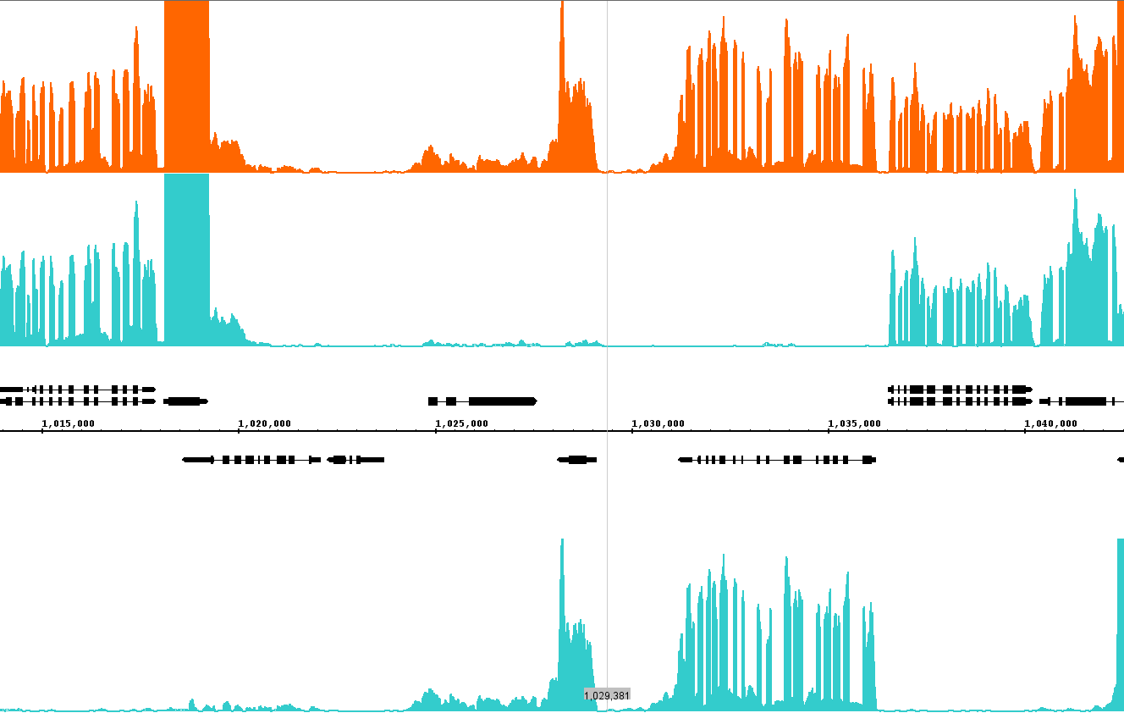
image Schurch 2014
Notes:
RNAs can sometimes come from overlapping genes on opposite strands. To enable the detection of which stand and RNA comes from and hence which gene it is useful to perform stranded RNA-seq. This is a recent innovation many older dataset are unstranded.

Slide 17
RNA-Seq Experimental Design
“Although the principles of good design are straightforward, their proper implementation often requires significant planning and statistical expertise.”
(Auer & Doerge 2010 Genetics)

Slide 18
replication
  the more times something is repeated, the greater the confidence of ending up with a genuine result.
    biological replicates – different biological samples
    technical replicates – same biological unit processed multiple times
randomization
  experimental subjects must be allocated to treatment groups at random
record covariates,
  including processing day – likely 'batch effects'
Notes:
The key ingredients of an RNA-seq experiment are much the same as those of any well designed experiment.

Slide 19
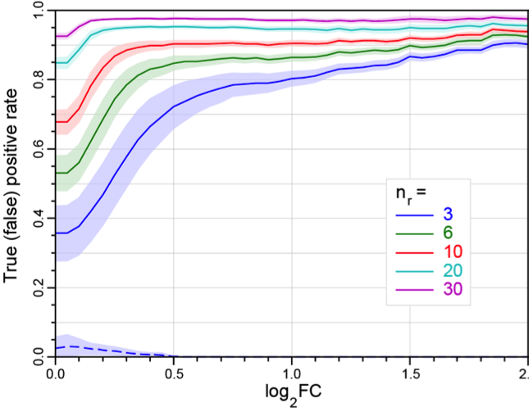
image Schurch et. al. 2015
Notes:
This graph show the effect of number of replicates on the ability to detect as significant changing genes between two conditions. It was from and experiment with 42 replicates. The number of gene that were found as significantly different in the full 42 replicate analysis was take and the gold standard. The True positive rate reflect what proportion of these gold standard gene are identified as significant. The concept of log fold change is the log base 2 of the ratio of the expression in the two conditions

Slide 20
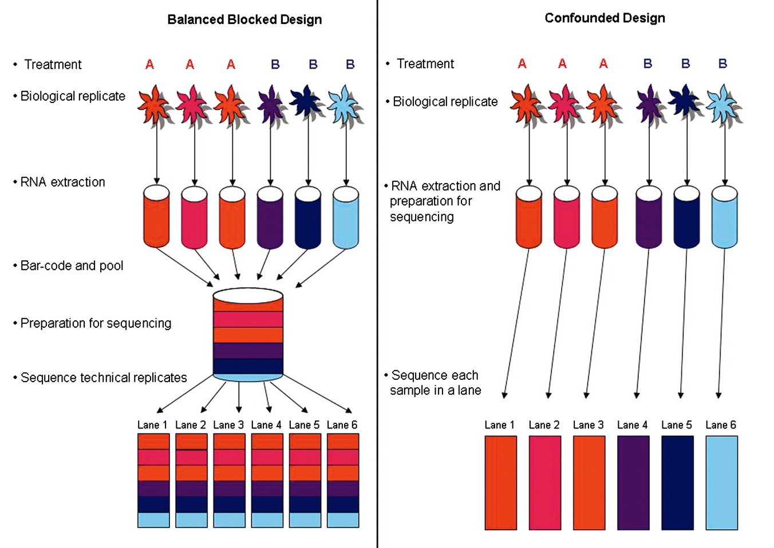
Image Auer & Dourge 2010 Genetics
Notes:
Mixing things up where possible is common sense. Do not do all of one condition with one kit (or on one day) and all of the other with a different kit for example, since it is impossible to tell if the effect is due to the conditions or the kit (or day)

Slide 21
RNA-seq Data Pre-processing
On two occasions I have been asked, "Pray, Mr. Babbage, if you put into the machine wrong figures, will the right answers come out?" ... I am not able rightly to apprehend the kind of confusion of ideas that could provoke such a question.
(Babbage 1864. Passages from the Life of a Philosopher.)

Slide 22
Fastq file.
  Raw read quality control (e.g. FastQC)
    base prediction qualities
    GC content
    over represented sequences
    k-mer content
  Reads may be spliced
Notes:
The same FastQC applies. Though often in RNA-seq for differential expression people are less fussy about QC, but for SNP detection and transcriptome assembly it is important.

Slide 23
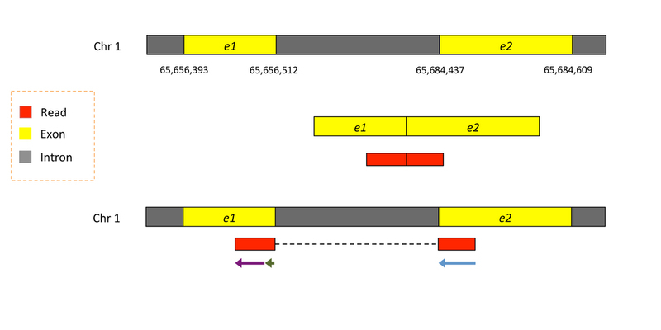
mRNA sequence tags (reads)
Notes:
Read come from RNA and RNA is often spliced, introns have been removed so

Slide 24
Use reads to quantify proportions of RNA transcripts
Use a genomic reference
  whole genome sequence
  one sequence per chromosome
Use a transcriptome reference
  sequences of the transcripts of interest
  one sequence per transcript
  Assemble transcripts from the reads de novo
Notes:
Use a genomic reference (whole genome sequence one sequence per chromosome)
align the reads to the reference
for list of regions associated with features of interest (typically genes) find how many reads map to those regions

Slide 25
de novo assembly
advantages
  you quantify the transcripts that are present
  novel gene models, alternative splicing
  not limited to existing annotation quality
disadvantages
  quality transcriptome assembly is non-trivial
  requires more depth sequence for than for simple DE
  introduce error
if your organism has not been sequenced this is your only option

Slide 26
Genomic reference alignment
spliced reads
  require splice aware aligner
relies on an existing genomic reference and feature annotation
  but if you look you might discover unannotated features and gene models
requires second processing step to quantify reads per feature

Slide 27
Transcriptome alignment
will only discover what is in your reference
faster
  get away with non-splice aware aligner
  no second mapping step

Slide 28
Reads that map to multiple features
multi mapping reads
  repetitive regions
  copy number, pseudogenes
  often the approach is to randomly select one of the possible locations
over lapping genes on opposite strands
  strand specific libraries can help here
alternative transcript models

Slide 29
RNA-Seq exploration
"You can't fix by analysis what you bungled by design."
Light, Singer and Willett (1990)
Notes:
But you can have a go!

Slide 30
Look for and correct for unwanted variance
Normalisation
  library size
  total RNA composition
  gene length
  GC content
TPM vs. RPKM/FPKM
  FPKM fragments per 1000 bases per million fragments (library size then gene length)
  TPM transcripts per million (gene length then library size)
Notes:
Exploring the raw data is important to reveal potential problems and biases in the data. Some of these can be adjusted for through “normalisation”. However some analysis and statistical inference performs modeling on adjusted (normalised) data and others use the raw data but include the adjustments in the model rather than the data.

Slide 31
RNA-seq Visualisation
“Numerical quantities focus on expected values, graphical summaries on unexpected values."
John Tukey

Slide 32
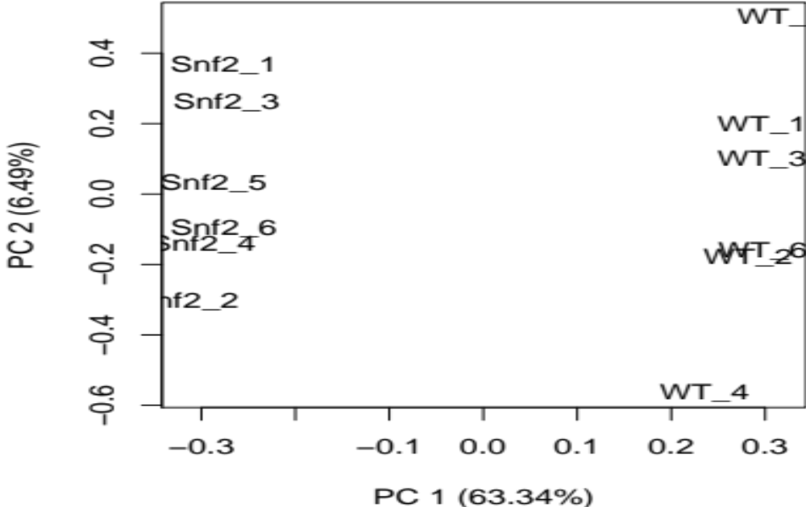
PCA Plot: first two principal components (cf. multi-dimensional scaling MDS Plot)
Notes:
“PCA is mathematically defined as an orthogonal linear transformation that transforms the data to a new coordinate system such that the greatest variance by some projection of the data comes to lie on the first coordinate (called the first principal component), the second greatest variance on the second coordinate, and so on.”
“MDS is used to reduce the dimensionality by giving the dissimilarity scores from each pair of expression profiles”

Slide 33
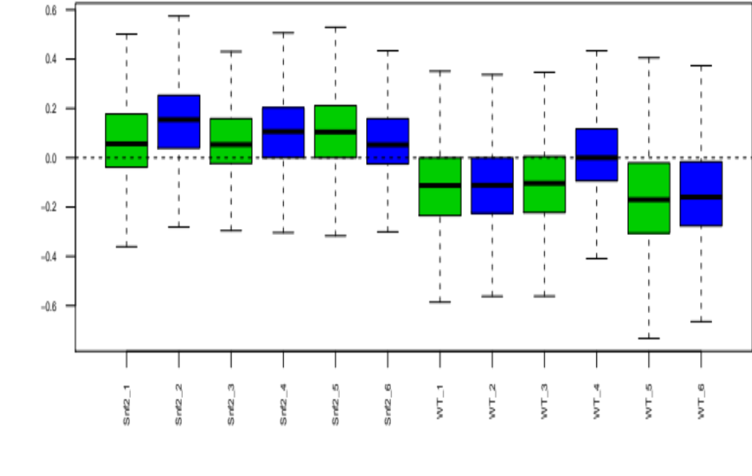
Boxplots and relative log expression (RLE) plots
Notes:
It can be helpful to visualise the distribution of expression in the samples. The relative log expression plot shows the distribution of the genes in each sample relative to the median expression of all genes across all samples. This can highlight issues such as here there appears to be higher expression recorded in the Snf2 mutant samples than in the WT samples. While this might be a real biological issue it might also be worth investigating if there is a batch effect here.

Slide 34
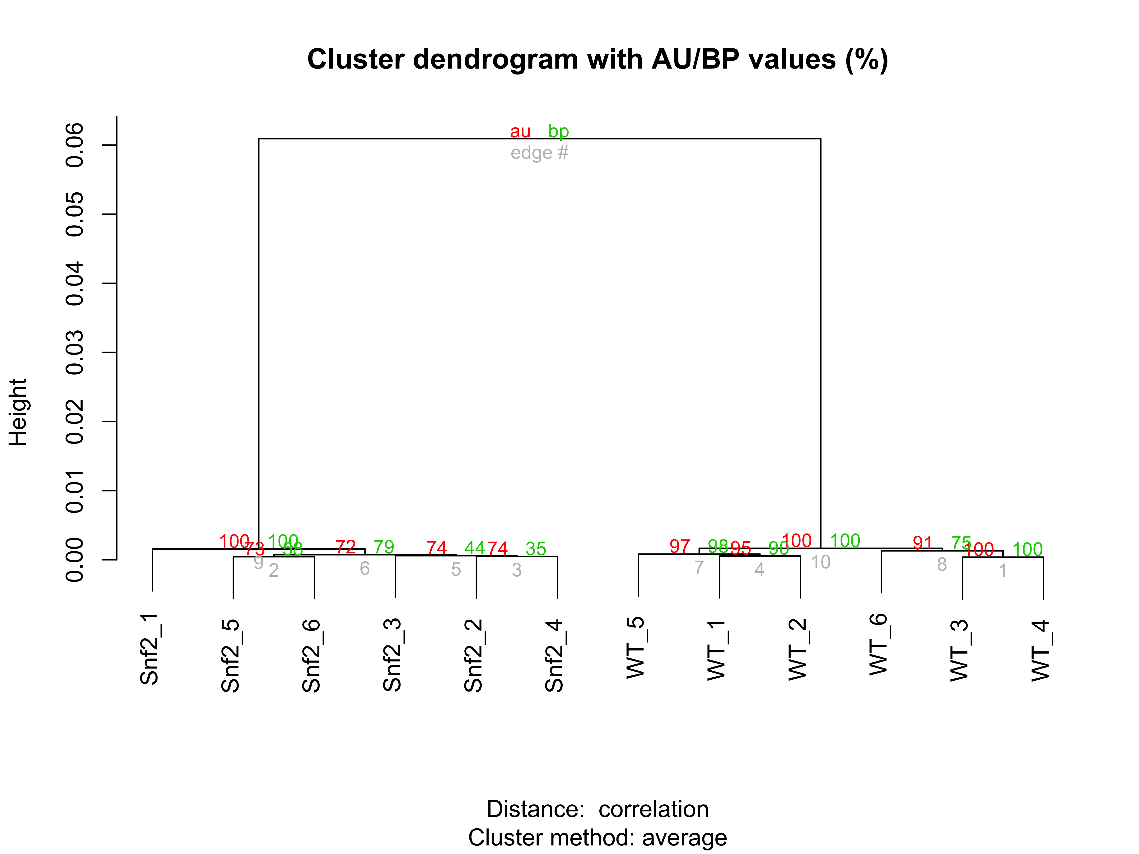
Dendrogram (cluster analysis)
Notes:
Hierarchical aglomerative clustering can also reveal relationships between samples. Here the clustering was performed on the distance between the samples as measured by the strength of the correlation between gene expression profiles.

Slide 35
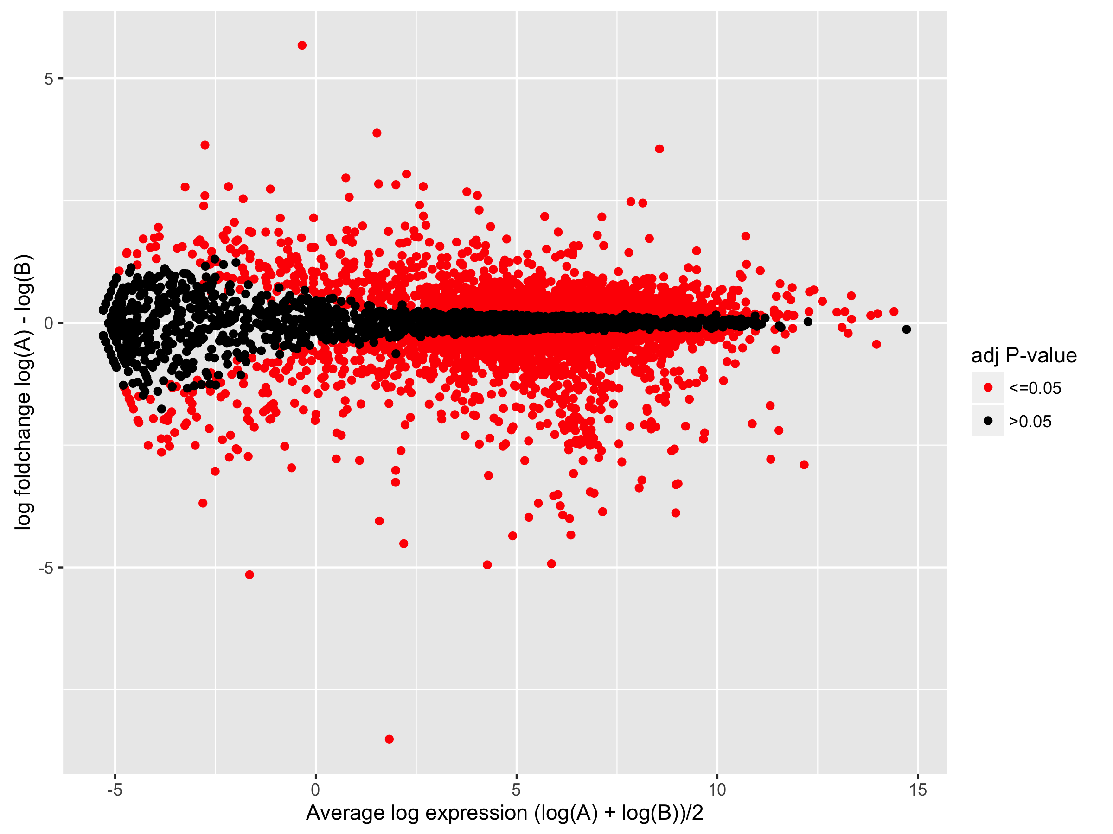
MA Plot: difference of the log expressions versus the mean log expression (Bland-Altman or Tukey Mean-Difference Plot)
Notes:
A common plot in differential expression analysis visualisation is the MA plot M is the measure of differential expression (often the log or the ratio the expression in the two conditions) and A is the mean expression of the two conditions.

Slide 36
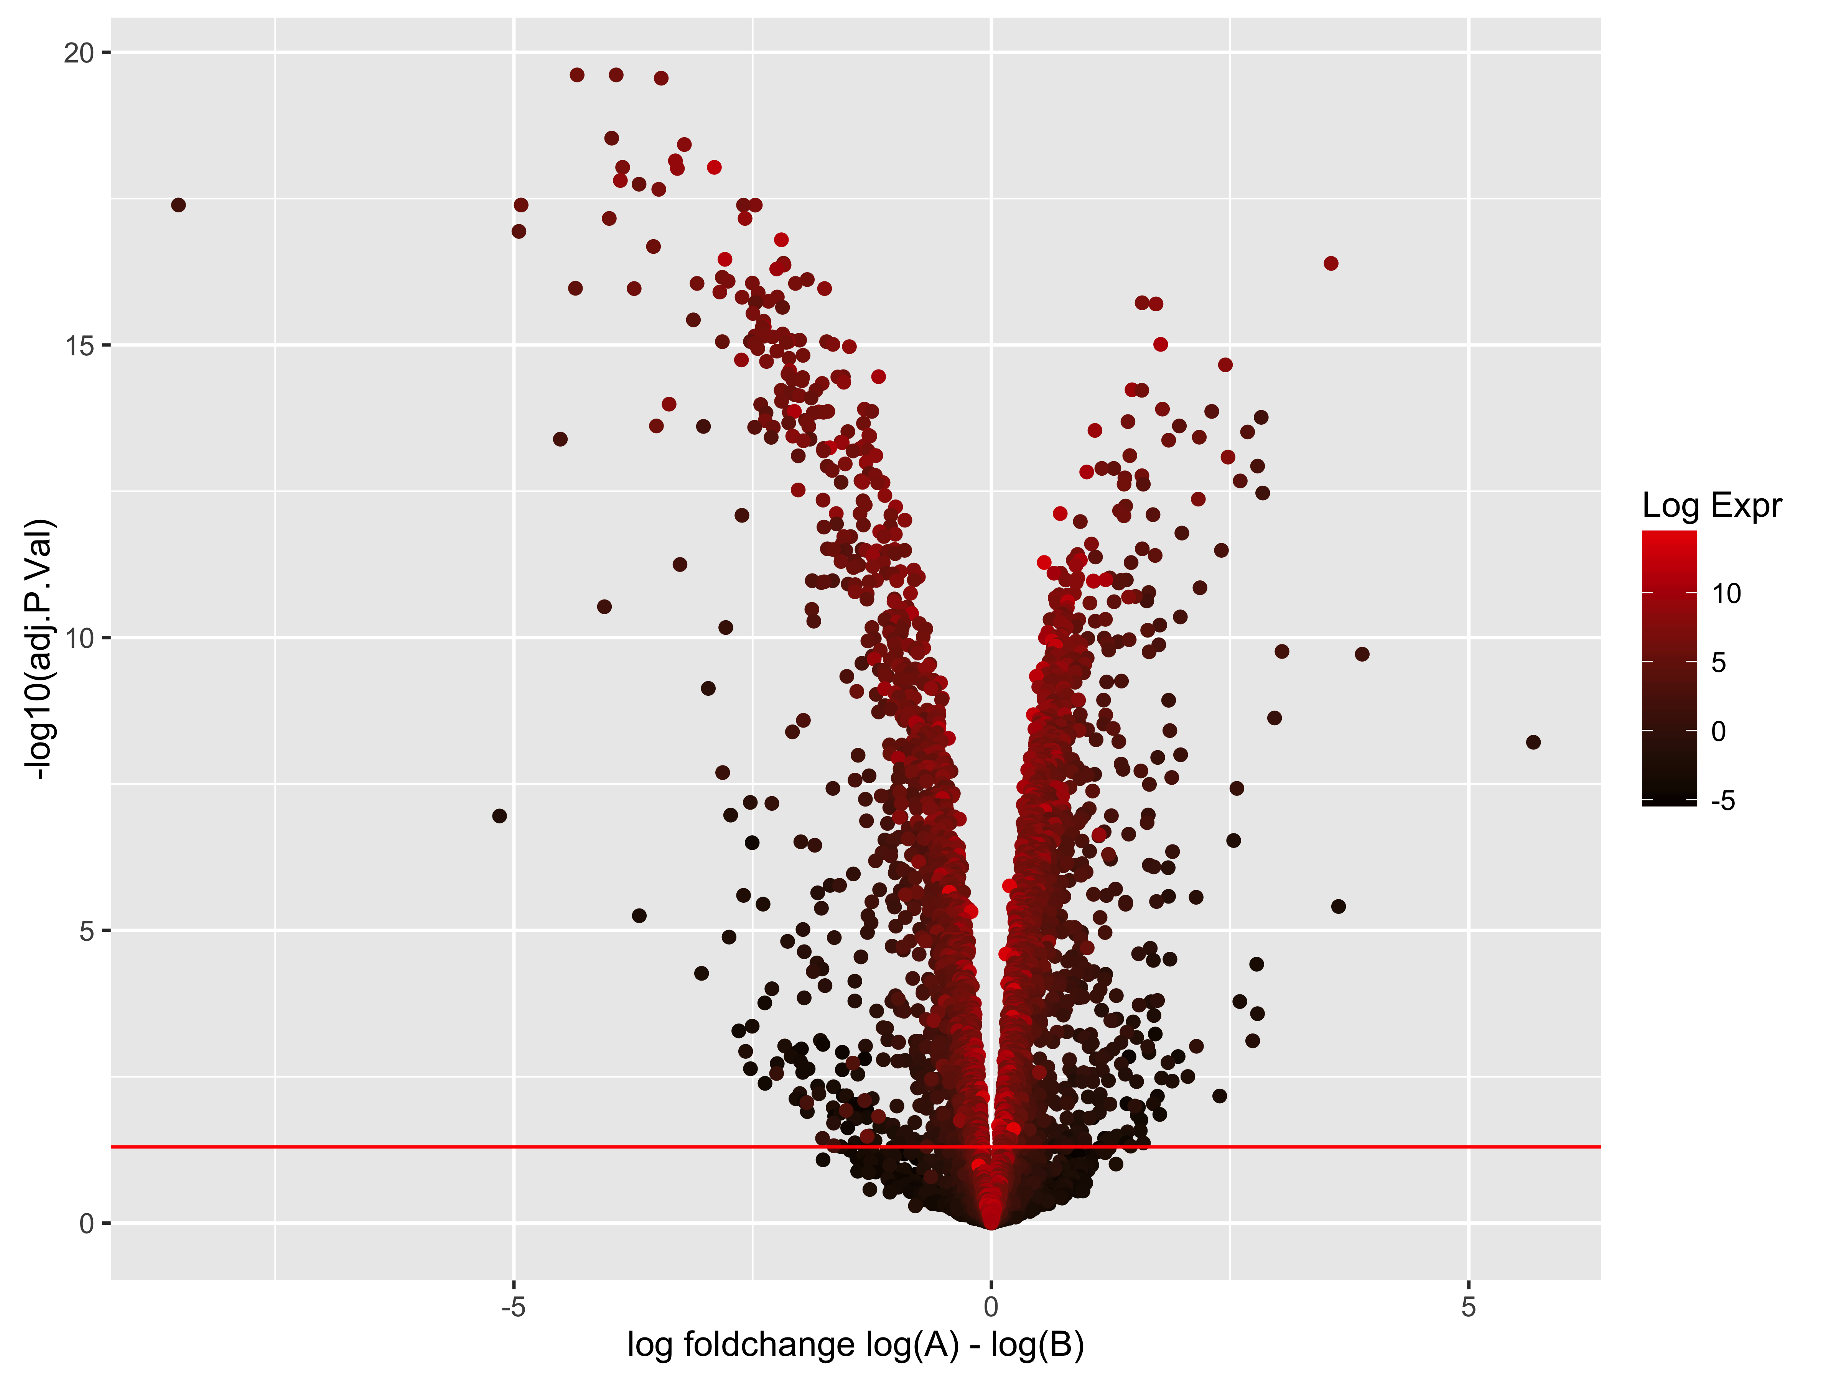
Volcano Plot
Notes:
Volcano plots attempt to plot the fold change (the M value of the MA plot) against the statistical significance value (adjusted p-value or False discovery rate).

Slide 37
RNA-Seq downstream processing
"Modern statisticians are familiar with the notion that any finite body of data contains only a limited amount of information on any point under examination; that this limit is set by the nature of the data themselves, and cannot be increased by any amount of ingenuity expended in their statistical examination"
R. A. Fisher
Notes:
There is no point flogging a dead horse.

Slide 38
Gene Set Enrichment
  Pathway analysis
  Gene Ontology functional annotation analysis
  Gene Network analysis
Notes:
Sets of significantly enriched genes are then generally tested to see if there is any significantly over representation of particular annotations attached to the set of genes. For example are gene fro any signaling pathways or biological functions particular highly represented in the set. To do this various annotation databases can be examined including the Gene Ontology database that holds annotation information on genes regarding particular biological processes, molecular functions and cellular compartments associated with genes

Slide 39
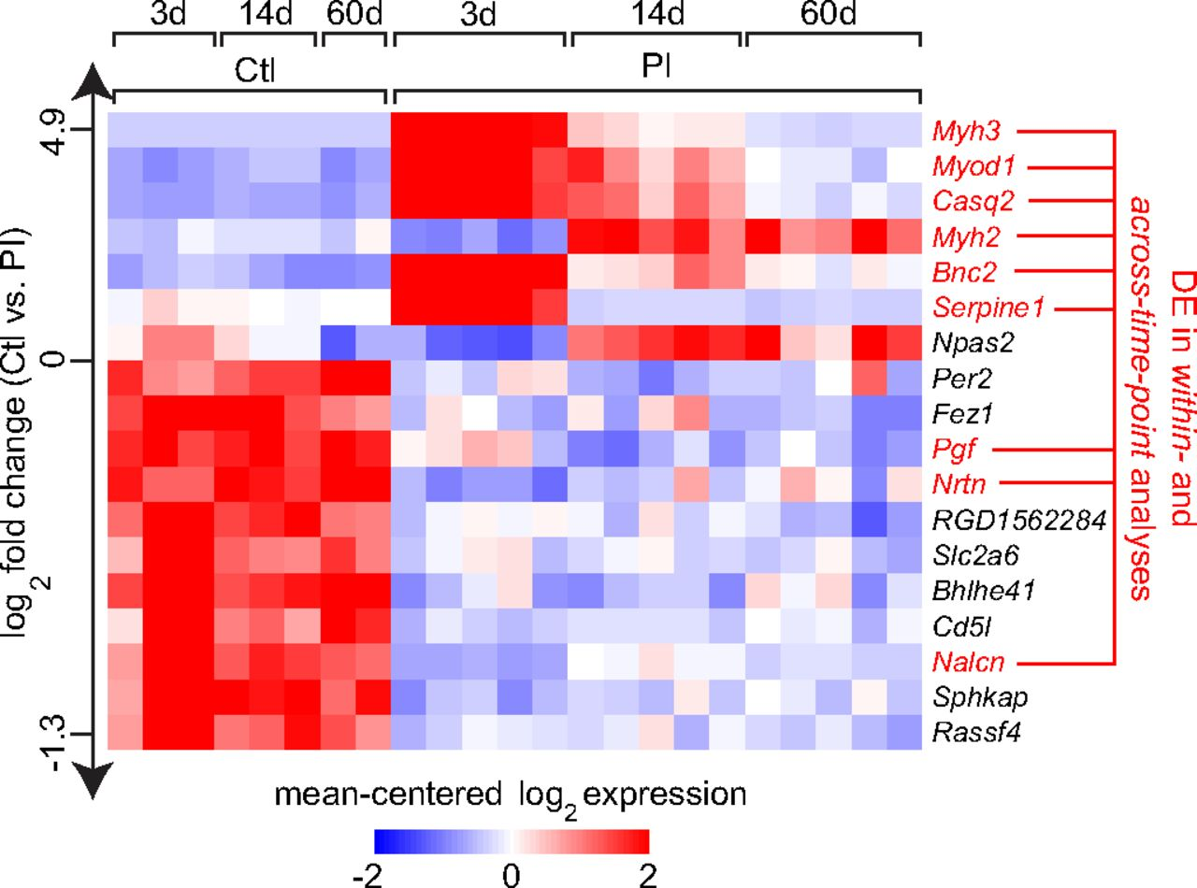
Image Welham et. al. 2015 Dis. Mod. Mech.
Notes:
When there a multiple conditions for example cell cycle times cluster analysis can be performed to discover sets of genes that are performing in the same way across conditions. This is often visualised as heatmaps

Slide 40
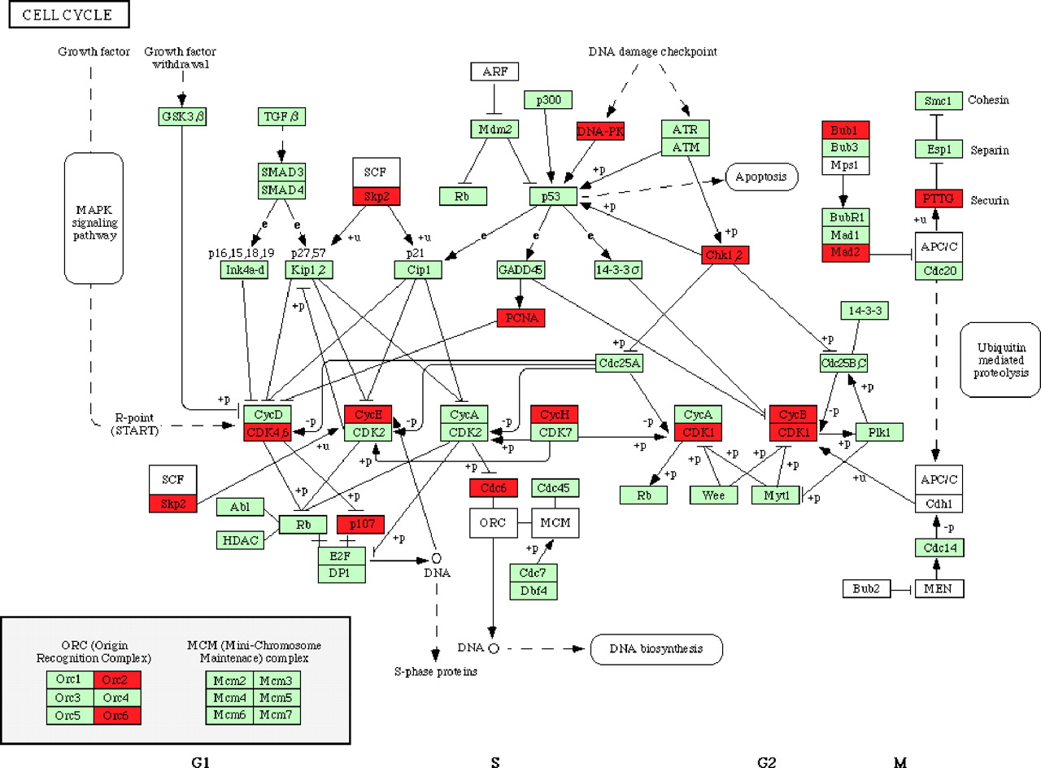
Image King et. al. 2005 Physio. Gen.
Notes:
Pathway maps showing which genes are up or down regulated are also useful.

Slide 41
Analysis Software
“Reinventing the wheel is sometimes the right thing, when the result is the radial tire.”
Jonathan Gilbert
Notes:
The expression “Don’t reinvent the wheel” is a common one, however people are always convinced that they are adding something novel that gives their wheel the edge over the competition or just an improvement over what has gone before. And it is certainly true seldom is the first iteration of a design perfect, new insights and understanding do need incorporating.

Slide 42
Quality Control
  FastQC, FASTX-Toolkit, trimmomatic, seqtk...
  R Bioconductor
Assembly
  trinity, SOAP denovo-Trans...
  cufflinks
Aligners, optimal depends on downstream task
  bowtie, bwa-mem, subread....
  tophat, subjunt, STAR,...
  kallisto, salmon
  R Bioconductor
  https://en.wikipedia.org/wiki/List_of_sequence_alignment_software
Notes:
There are multiple implimentations of very similar software tools and often which you use is a matter of personal preference however in some cases some are considered more appropriate for some applications.
Aligners for example, RNA-seq generally requires a splice aware aligner however for simple differential expression analysis subread will surface however for variant calling and snp analysis a more careful aligner such as BWA-MEM is recommended.

Slide 43
Alignment Processing
  samtools, sambamba, picard
  R Bioconductor
Data Exploration
  R Bioconductor
    RUVSeq, NOISeq, EDASeq...
Differential Expression
  RSEM...
  cuffdiff...
  R Bioconductor
    edgeR, limma, DESeq...
    sleuth
Notes:
Once alignment has been performed there are also many choices for software to manipulate and analyse the result of the alignment

Slide 44
GSEA
  Ingenuity Pathway Analysis
  R Bioconductor
  Panther
SNP variant calling
  GATK
  R Bioconductor
Notes:
And similarly there many tools for downstream processing

Slide 45
Integrated Analysis Environments
  CLC Bio
  Galaxy
  UGENE
  Pipeline Pilot
Notes:
While commercial packages and graphical environments for performing analysis are available and often of use for routine investigations

Slide 46
R Bioconductor
Suite of packages for the R Statistical Computing environment
pros
  an attempt at standards of documentation
  scriptable (extensible)
  reproducible (dynamic document production)
  extensive pre-existing libraries
  free
cons
  command line not point and click
  scripting language is R
  unfriendly (steep learning curve)
Notes:
It is useful also to be able to understand the details of what is being done. And sometimes to have access to results in a manner that enables extra investigations. Bioconductor which is a library of packages for the R statistical scripting language and environment is a free open source set of expanding tools.

Slide 47
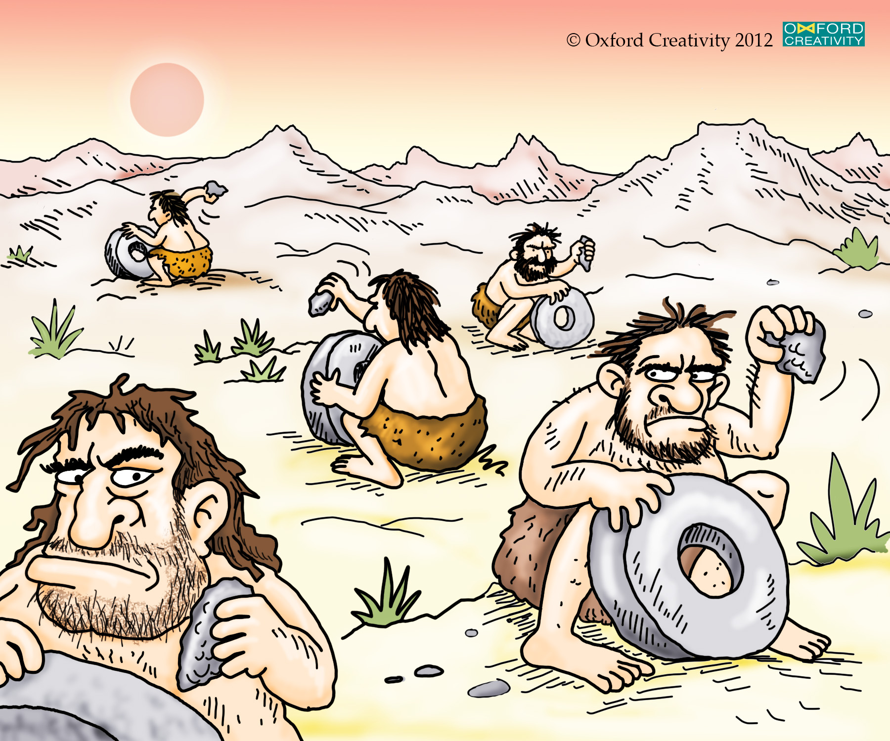
“The NIH (Not Invented Here) Syndrome is a disease”
Linus Torvalds https://en.wikipedia.org/wiki/Not_invented_here
Notes:
So people will always reinvent the wheel when they think their design provides new insight, or better performance or more trustworthy results. It is not always easy to judge which wheel to use, some may be better suited to some tasks than others and visa versa, and sometimes it comes down to personal preference or budget constraints.

