Slide 1
Introduction to
REPRODUCIBLE RESEARCH With
R, RStudio, RMarkown
Pieta Schofield

Slide 2
Motivation
“Let us save what remains: not by vaults and locks which fence them from the public eye and use, in consigning them to the waste of time, but by such a multiplication of copies, as shall place them beyond the reach of accident.”
Thomas Jefferson
Notes:
The expression “Don’t reinvent the wheel” is a common one, however people are always convinced that they are adding something novel that gives their wheel the edge over the competition or just an improvement over what has gone before. And it is certainly true seldom is the first iteration of a design perfect, new insights and understanding do need incorporating.

Slide 3
REPRODUCIBLE RESEACH the 3 R’s
Repeatability – obtain the same result from performing the same experiment with the same protocols under the same conditions
Reproducibility – obtain the same or similar result from performing a similar experiment with possible variations in protocols and conditions
Robustness – a measure of the invariance of the result to variability in protocol or conditions
To be able to repeat or reproduce the results of an experiment or analysis requires full documentation of materials and methods both data generation protocols and data analysis protocols and the publication of the data and code.

Slide 4
my 3 R’s
R
RStudio
Rmarkdown

Slide 5
LITERATE PROGRAMMING
“Let us change our traditional attitude to the construction of programs: Instead of imagining that our main task is to instruct a computer what to do, let us concentrate rather on explaining to human beings what we want a computer to do.”
Donald Knuth

Slide 6
R and RSTudio
“R is a free software environment for statistical computing and graphics” (i.e. for data analysis and visualisation)
https://www.r-project.org
Scriptable command line interface
“RStudio Integrated Development Environment (IDE) is a powerful and productive user interface for R. It’s free and open source, and works great on Windows, Mac, and Linux.”
https://www.rstudio.com
Currently the leading interface on to R with lots of point and click navigable tools to ease the pain of the R learning curve.
Server version accessible via web-browser interface
School of Life Science RStudio Server instance

Slide 7
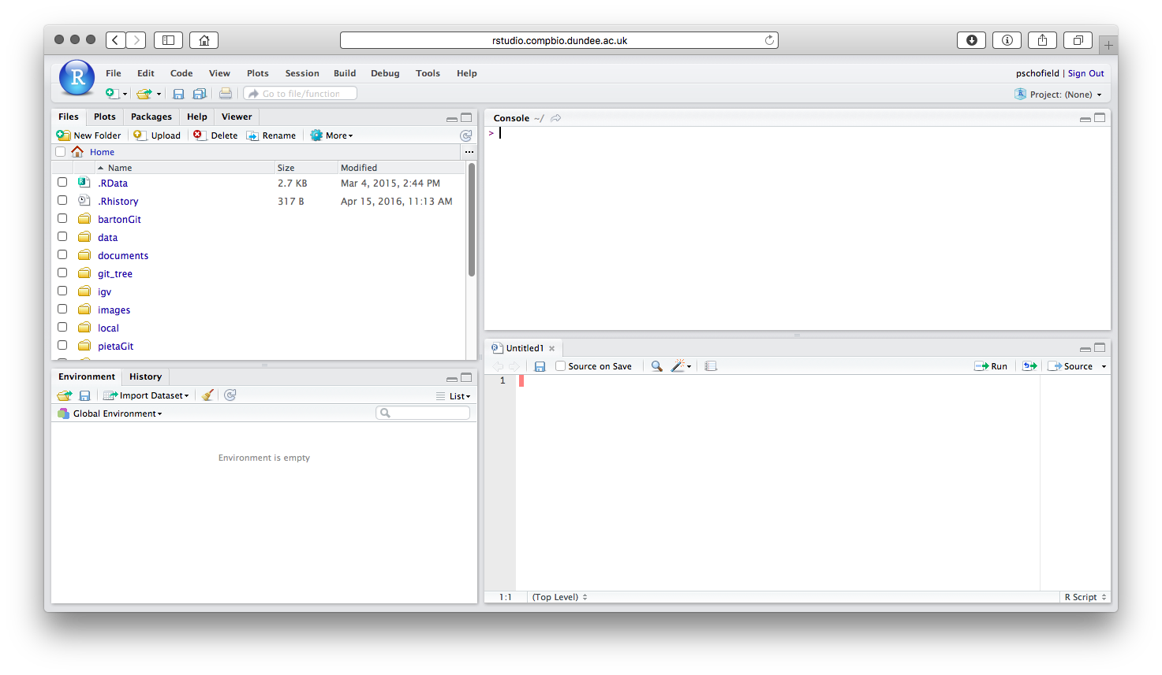
RSTUDIO SERVER

Slide 8
RMARKDOWN
“R Markdown is an authoring format that enables easy creation of dynamic documents, presentations, and reports from R”
Record a human language description of your analysis with some formatting code characters and embed the chunks of R code that perform the analysis in the document.
Compile the script to create a final document that includes your formatted descriptive text, your code and the outputs, result and graphs from your code
Create Word, PDF document, PDF slide presentations, HTML web-pages, HTML slide presentations
Keep a lab-book of your analysis with the code and the result all in one document.

Slide 9
Practical
Go to the practical pages

