Slide 1
Introduction to
RNA-seq
Pietà Schofield

Slide 2
RNA-Seq Motivation
“Living systems are dynamic and complex, and their behavior may be hard to predict from the properties of individual parts.”
(Website of the Department of Systems Biology, Harvard Medical School)

Slide 3
Applications of RNA-seq
Transcriptome Assembly
  Identify the sequences of the RNA’s in the sample
  Identify rare non-canonical transcripts alternate splicing
  Quantify relative amounts of these transcripts
Differential expression
  Identify which gene/transcript change between different conditions
SNP and splice variant detection.
Notes:
RNA-seq can be used for several applications.

Slide 4
RNA-seq vs MICROARRAY
Whole transcriptome
  but can be targeted at specific regions
Disadvantages of microarrays
  probes decided on in advance, can only detect what you look for
  complicated normalisation required to account for within and between array technical variation
Perceived advantages of RNA-seq
  probe free, whole transcriptome discovery
  "simpler" more direct measure of transcripts counts
  novel organisms with no existing arrays
Notes:
RNA-seq attempts to be a better alternative, As we will see later the normalisation issue is not really much simpler.

Slide 5
Library prep
Sequencing
RNA-seq Data
Generic Analysis
fastq files
Quality
Control
fastq files
Transcript Assembly
Third Party
Curated Reference
Data
fastq files
Alignment
fasta file
Reference
Sequence
bam/sam
SNP calling
Feature
Assignment
gtf/gff files
Reference
Annotation
count matrix
Gene Set/Pathway
Analysis
KEGGdb
GOdb
STRINGdb
etc.
Expression Analysis
Expression
Results
Functional
Reference

Slide 6
RNA-Seq Library Prep
“For measurements to be meaningful, however, they must retain their connection to the theoretical and instrumental context from which they were derived. “
(Houle et. al. 2011 Q. Rev. Biol.)

Slide 7
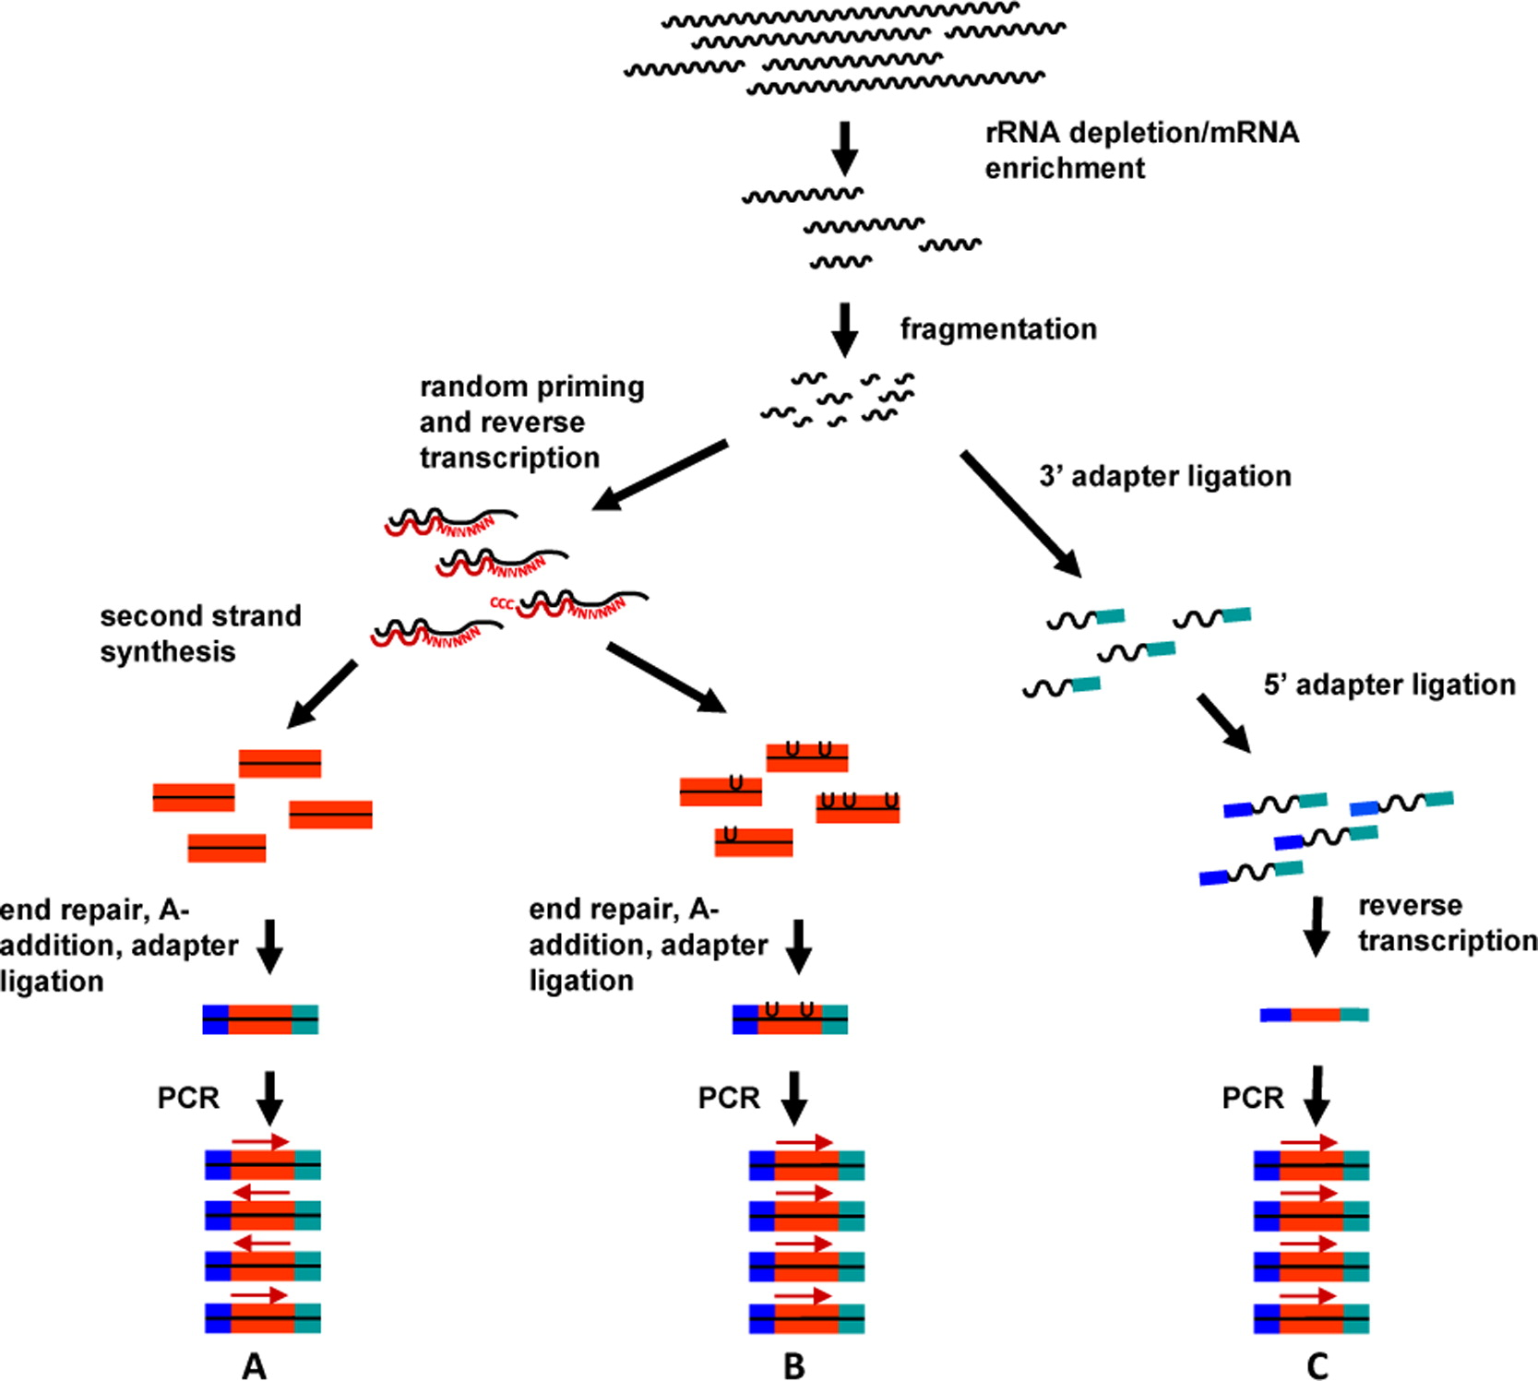
Library Preparation
Image van Dijk et. al. (2014) Exp Cell Res
Notes:
To get a signal in the data for the 2-5% of the “interesting” RNA the uninteresting rRNA must be removed first

Slide 8
Library Preparation
Enrich for non ribosomal RNA
  ~75% of RNA is ribosomal RNAs (rRNA)
  ~10% of RNA is transfer RNAs (tRNA)
  ~2% of RNA is protein coding messenger RNAs mRNA
  Remainder is mix of small and long non-coding mirRNA, snoRNA, lncRNA etc. (Jackson et. al. FASEB J. 2000 )
Fragment
  Add primers
Reverse transcribe
  Can produce strand specific cDNA’s
Amplify what is left
  PCR can introduce bias
Then sequence
  more often than not these days with Illumina

Slide 9
MRNA enrichment/RRNA Depletion
Deplete the rRNA
  Ribo-Zero kits remove ribosomal RNA (rRNA) using a hybridization/bead capture procedure that selectively binds rRNA species using biotinylated capture probes.
  Will leave non-polyadenylated species miRNA, snoRNA etc.
Poly-A pulldown
  Poly(A) enrichment involves the capture of the 3´-end of polyadenylated RNA, typically using oligo(dT) columns. If the RNA to be enriched is of high quality, then most of the mRNA will be recovered.
  If protein coding and many (majority) lncRNA are the focus this may give clearer signal
Notes:
Most of the RNA in a cell is ribosomal RNA (the machine that translates RNA to protein) or transfer RNA the chaperone that carries amino acid residues to the ribosome.

Slide 10
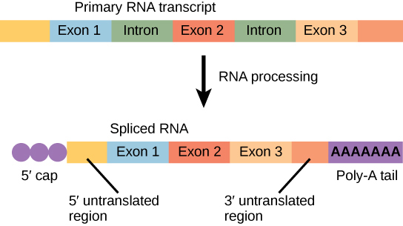
pre vs mature mRNA
Image https://cnx.org/contents/TkuNUJis@3/Transcription
Notes:
most of the interesting RNA has a polyA tail and a 5’ cap this can be used for pulling the interesting RNA out of the sample. The alternative if you want to have interesting RNA that doesn’t have a polyA tail is to use a ribosomal RNA depletion kit

Slide 11
Relative GENE EXPRESSion
Generally however sequencing is not quantitative it is proportional because sample is scale up to a fix volume
Sample A
Sample B
Extracted
Sequenced
Extracted
Sequenced

Slide 12
Spike-INS
Sample A
Sample B
Extracted
Sequenced
Extracted
Sequenced
Notes:
In an attempt to get some measure of quantitation it is possible to put in a fixed amount of known artificial RNAs called “spike-ins” into the library. The relative proportion of the genetic to the artificial RNA give a measure of how much total genetic RNA was in the mix

Slide 13
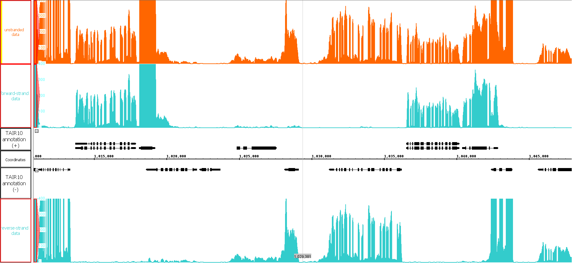
Stranded Sequencing
image Schurch 2014
Notes:
RNAs can sometimes come from overlapping genes on opposite strands. To enable the detection of which stand and RNA comes from and hence which gene it is useful to perform stranded RNA-seq. This is a recent innovation many older dataset are unstranded.

Slide 14
RNA-Seq Experimental Design
“Although the principles of good design are straightforward, their proper implementation often requires significant planning and statistical expertise.”
(Auer & Doerge 2010 Genetics)

Slide 15
ExperimEntal Design
replication
  the more times something is repeated, the greater the confidence of ending up with a genuine result.
    biological replicates – different biological samples
    technical replicates – same biological unit processed multiple times
randomization
  experimental subjects must be allocated to treatment groups at random
record covariates,
  including as much information as possible, for each sample
  batch, kit, day, person, (it may help to identify and explain issues that become apparent during analysis)
Notes:
The key ingredients of an RNA-seq experiment are much the same as those of any well designed experiment.

Slide 16
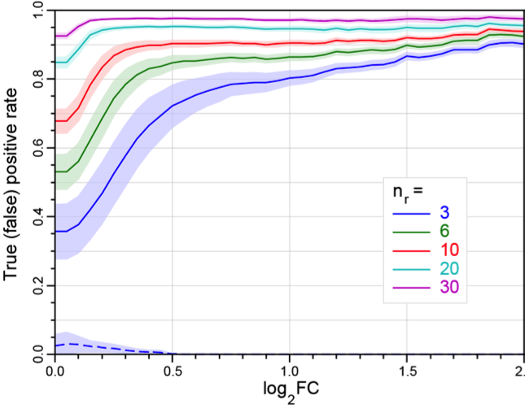
Replicates
image Schurch et. al. 2015
Notes:
This graph show the effect of number of replicates on the ability to detect as significant changing genes between two conditions. It was from and experiment with 42 replicates. The number of gene that were found as significantly different in the full 42 replicate analysis was take and the gold standard. The True positive rate reflect what proportion of these gold standard gene are identified as significant. The concept of log fold change is the log base 2 of the ratio of the expression in the two conditions

Slide 17
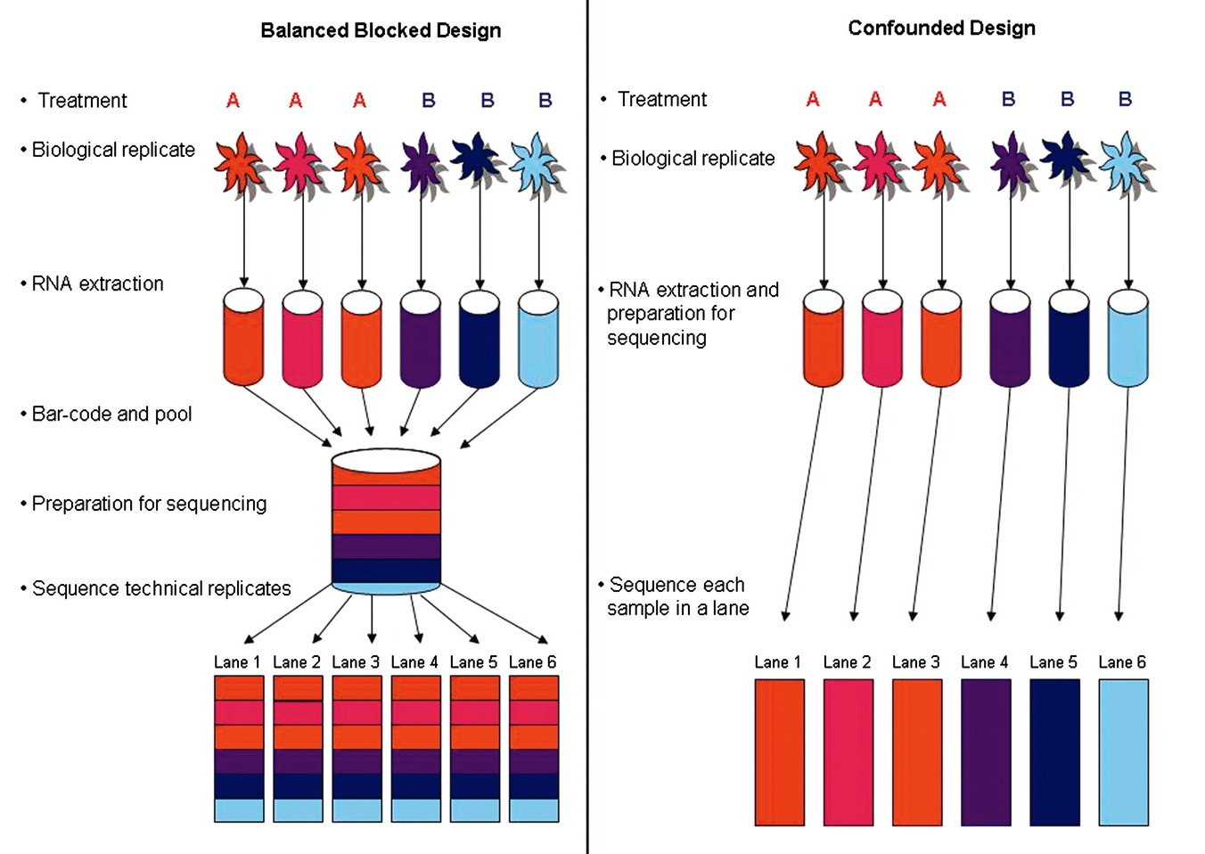
Balanced Blocked Design
Image Auer & Dourge 2010
Notes:
Mixing things up where possible is common sense. Do not do all of one condition with one kit (or on one day) and all of the other with a different kit for example, since it is impossible to tell if the effect is due to the conditions or the kit (or day)

Slide 18
RNA-seq Data processing
On two occasions I have been asked, "Pray, Mr. Babbage, if you put into the machine wrong figures, will the right answers come out?" ... I am not able rightly to apprehend the kind of confusion of ideas that could provoke such a question.
(Babbage 1864. Passages from the Life of a Philosopher.)

Slide 19
The Raw DATA
Generally comes as a FASTQ file.
  Raw read quality control (e.g. FastQC)
    base prediction qualities
    GC content
    over represented sequences
    k-mer content
Notes:
The same FastQC applies. Though often in RNA-seq for differential expression people are less fussy about QC, but for SNP detection and transcriptome assembly it is important.

Slide 20
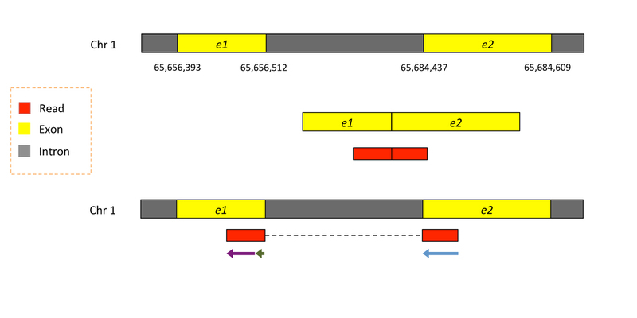
READS CAN SPAN SPLICE JUNCTION
Notes:
Read come from RNA and RNA is often spliced, introns have been removed so

Slide 21
Alignment
Choice of a reference to align to
Genomic reference
  whole genome sequence
  one sequence per chromosome
Transcriptome reference
  Existing or de novo assembly
  sequences of the transcripts of interest
  one sequence per transcript
  Assemble transcripts from the reads de novo
Notes:
Use a genomic reference (whole genome sequence one sequence per chromosome)
align the reads to the reference
for list of regions associated with features of interest (typically genes) find how many reads map to those regions

Slide 22
de novo assembly
advantages
  you quantify the transcripts that are present
  novel gene models, alternative splicing
  not limited to existing annotation quality
disadvantages
  quality transcriptome assembly is non-trivial
  requires more depth sequence for than for simple DE
  introduce error
if your organism has not been sequenced this is your only option

Slide 23
Genomic Vs Transcriptomic
Genomic
  spliced reads
  require splice aware aligner
  separate feature quantification step
  relies on an existing genomic reference
  you might see potential new features in unannotated regions
Transcriptomic
  Existing or de novo assembly
  will only discover what is in your reference
  get away with non-splice aware aligner (faster)
  no second mapping step

Slide 24
TRANSCRIPTS VS GENEs
Reads that map to multiple features
multi mapping reads
  repetitive regions
  copy number, pseudogenes
  often the approach is to randomly select one of the possible locations
over lapping genes on opposite strands
  strand specific libraries can help here
alternative transcript models

Slide 25
RNA-Seq exploration
"You can't fix by analysis what you bungled by design."
Light, Singer and Willett (1990)
Notes:
But you can have a go!

Slide 26
unwanted variance
Sources of Unwanted Variation
library size
  different total numbers of reads in each sample
total RNA composition
  big changes in expression of a few genes change sequencing resources available to other genes cause false appearance of differential expression
gene length
  longer transcript generate more fragments
GC content
  unbalanced base compositions don’t sequence as well
batch effects
  different kits, different days, temperatures, planetary alignments...
Notes:
Exploring the raw data is important to reveal potential problems and biases in the data. Some of these can be adjusted for through “normalisation”. However some analysis and statistical inference performs modeling on adjusted (normalised) data and others use the raw data but include the adjustments in the model rather than the data.

Slide 27
RNA-seq Visualisation
“Numerical quantities focus on expected values, graphical summaries on unexpected values."
John Tukey

Slide 28
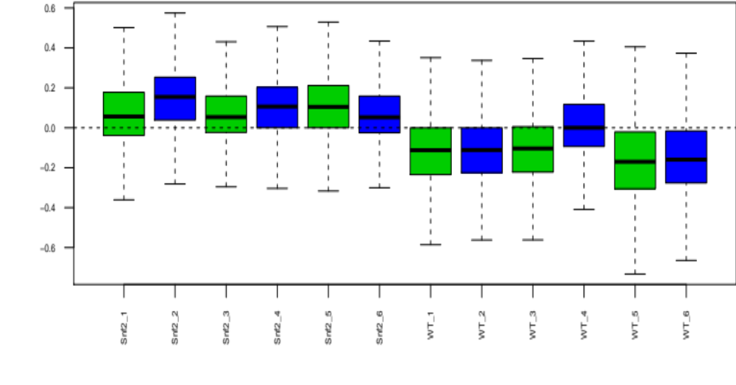
Boxplots
Notes:
It can be helpful to visualise the distribution of expression in the samples. The relative log expression plot shows the distribution of the genes in each sample relative to the median expression of all genes across all samples. This can highlight issues such as here there appears to be higher expression recorded in the Snf2 mutant samples than in the WT samples. While this might be a real biological issue it might also be worth investigating if there is a batch effect here.

Slide 29
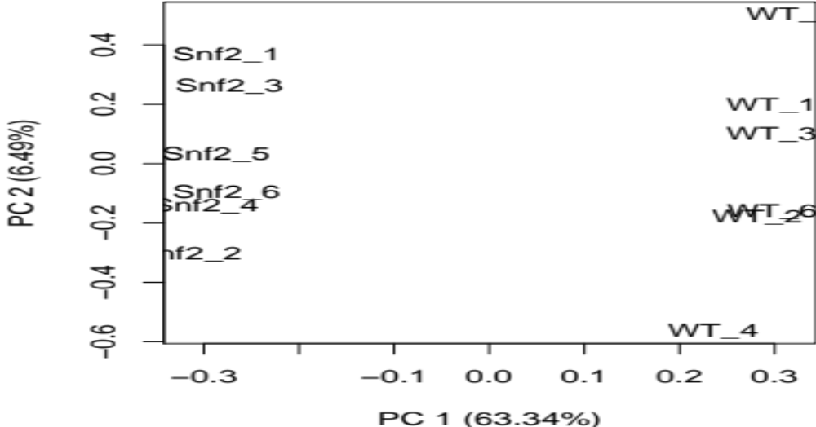
Multi-Dimensional Scaling
Notes:
“PCA is mathematically defined as an orthogonal linear transformation that transforms the data to a new coordinate system such that the greatest variance by some projection of the data comes to lie on the first coordinate (called the first principal component), the second greatest variance on the second coordinate, and so on.”
“MDS is used to reduce the dimensionality by giving the dissimilarity scores from each pair of expression profiles”

Slide 30
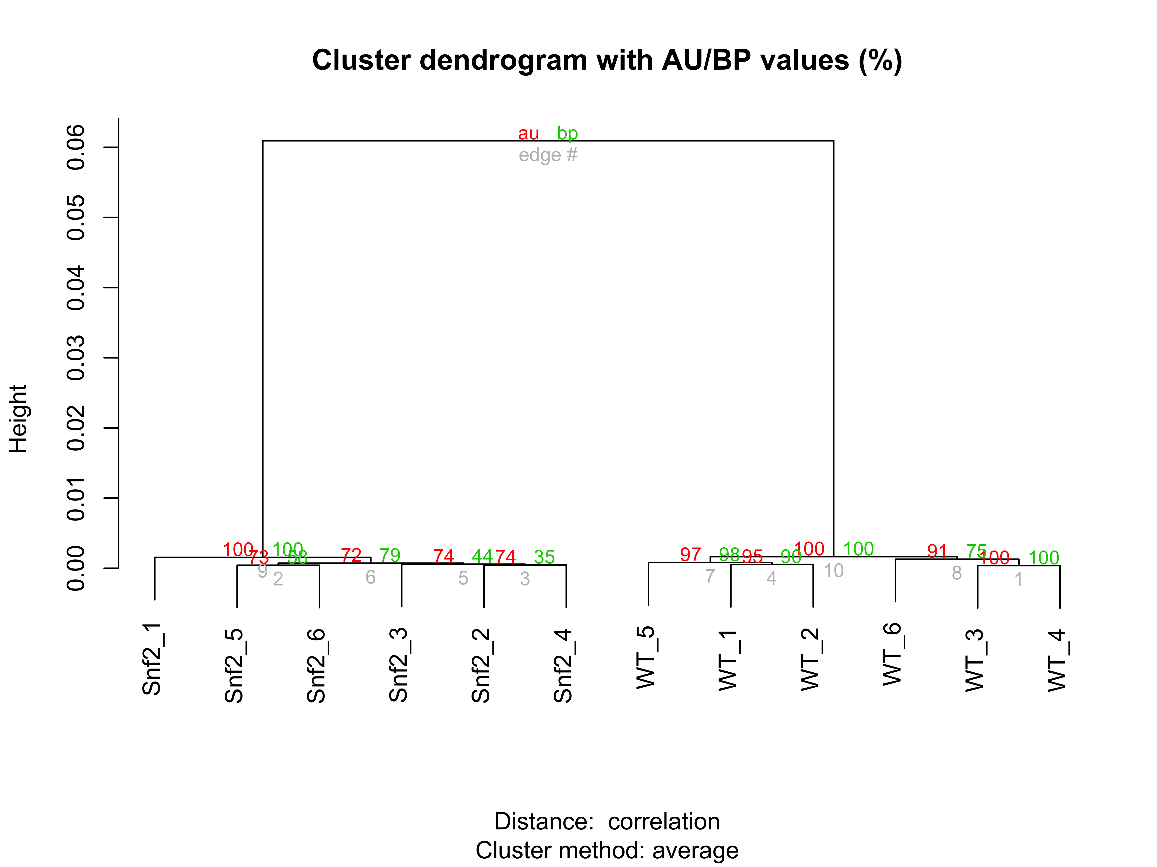
DendroGRAms (Clustering)
Notes:
Hierarchical aglomerative clustering can also reveal relationships between samples. Here the clustering was performed on the distance between the samples as measured by the strength of the correlation between gene expression profiles.

Slide 31
Practical
Reference Annotation and Alignment

