Slide 1
Differential Expression Analysis
Pieta Schofield

Slide 2
Statistics Refresher
"Statistics is, or should be, about scientific investigation and how to do it better, but many statisticians believe it is a branch of mathematics."
George E. P. Box

Slide 3
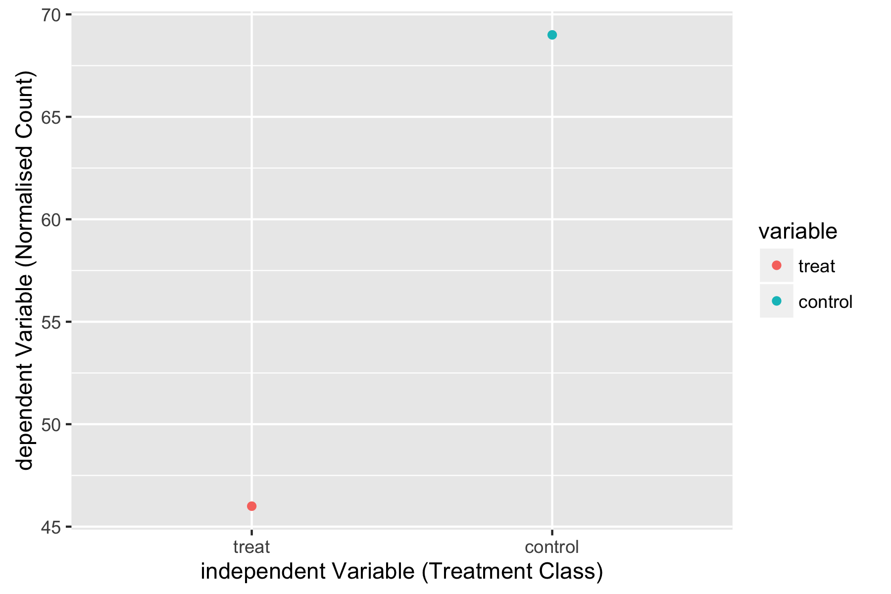
Two conditions is there a treatment effect?
Notes:
If you have two conditions say an treated and an untreated cell that you measure something about and you examine the numbers produced can you tell if the treatment has made an effect. How confident can you be.

Slide 4
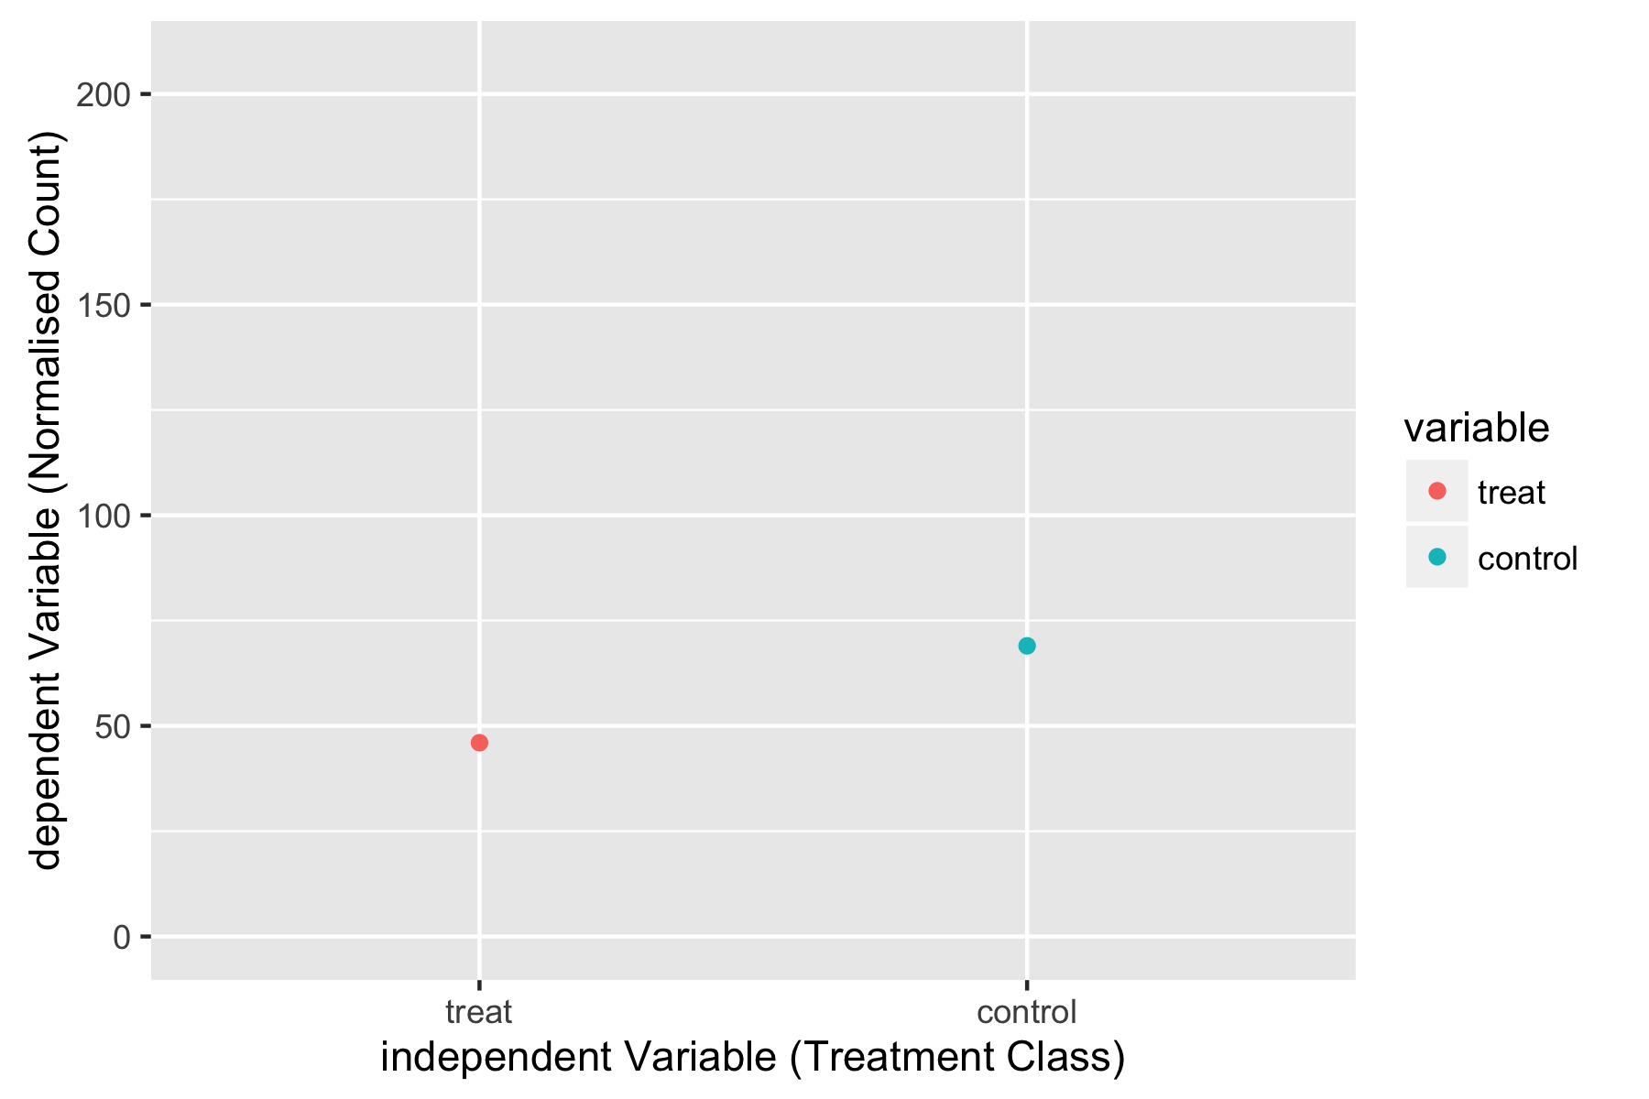
consider possible range of values
Notes:
if you look at it on another scale, for example you have an understanding of the range of possible values for your measure, this can alter your confidence

Slide 5
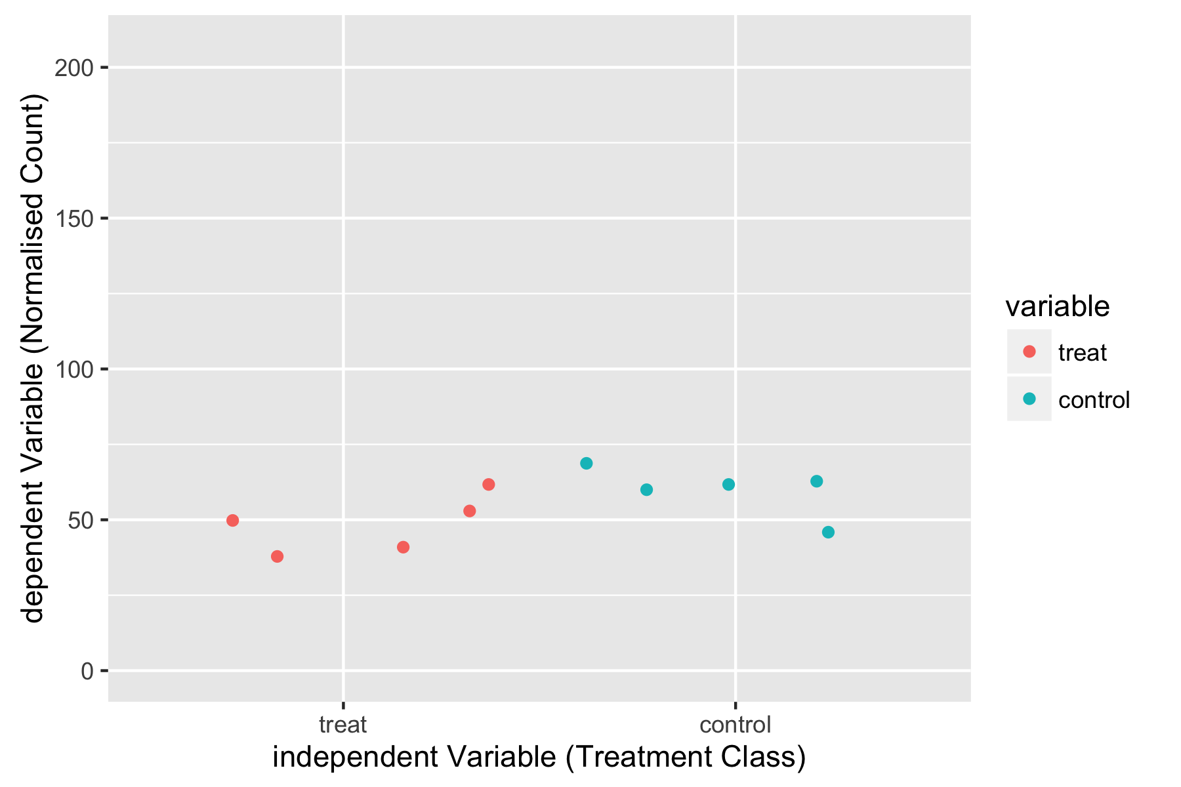
If more samples are considered
Notes:
One thing you can do is to measure it several time and work out over several separate measures if there is a consistent different, this increases you confidence

Slide 6
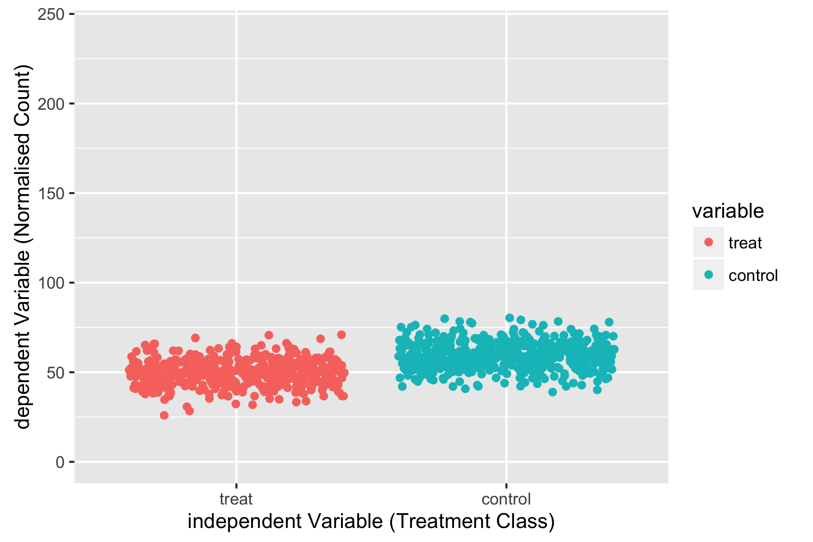
If lots of samples are considered
Notes:
If you measure it a huge number of times you may become totally convince you can see an effect.

Slide 7
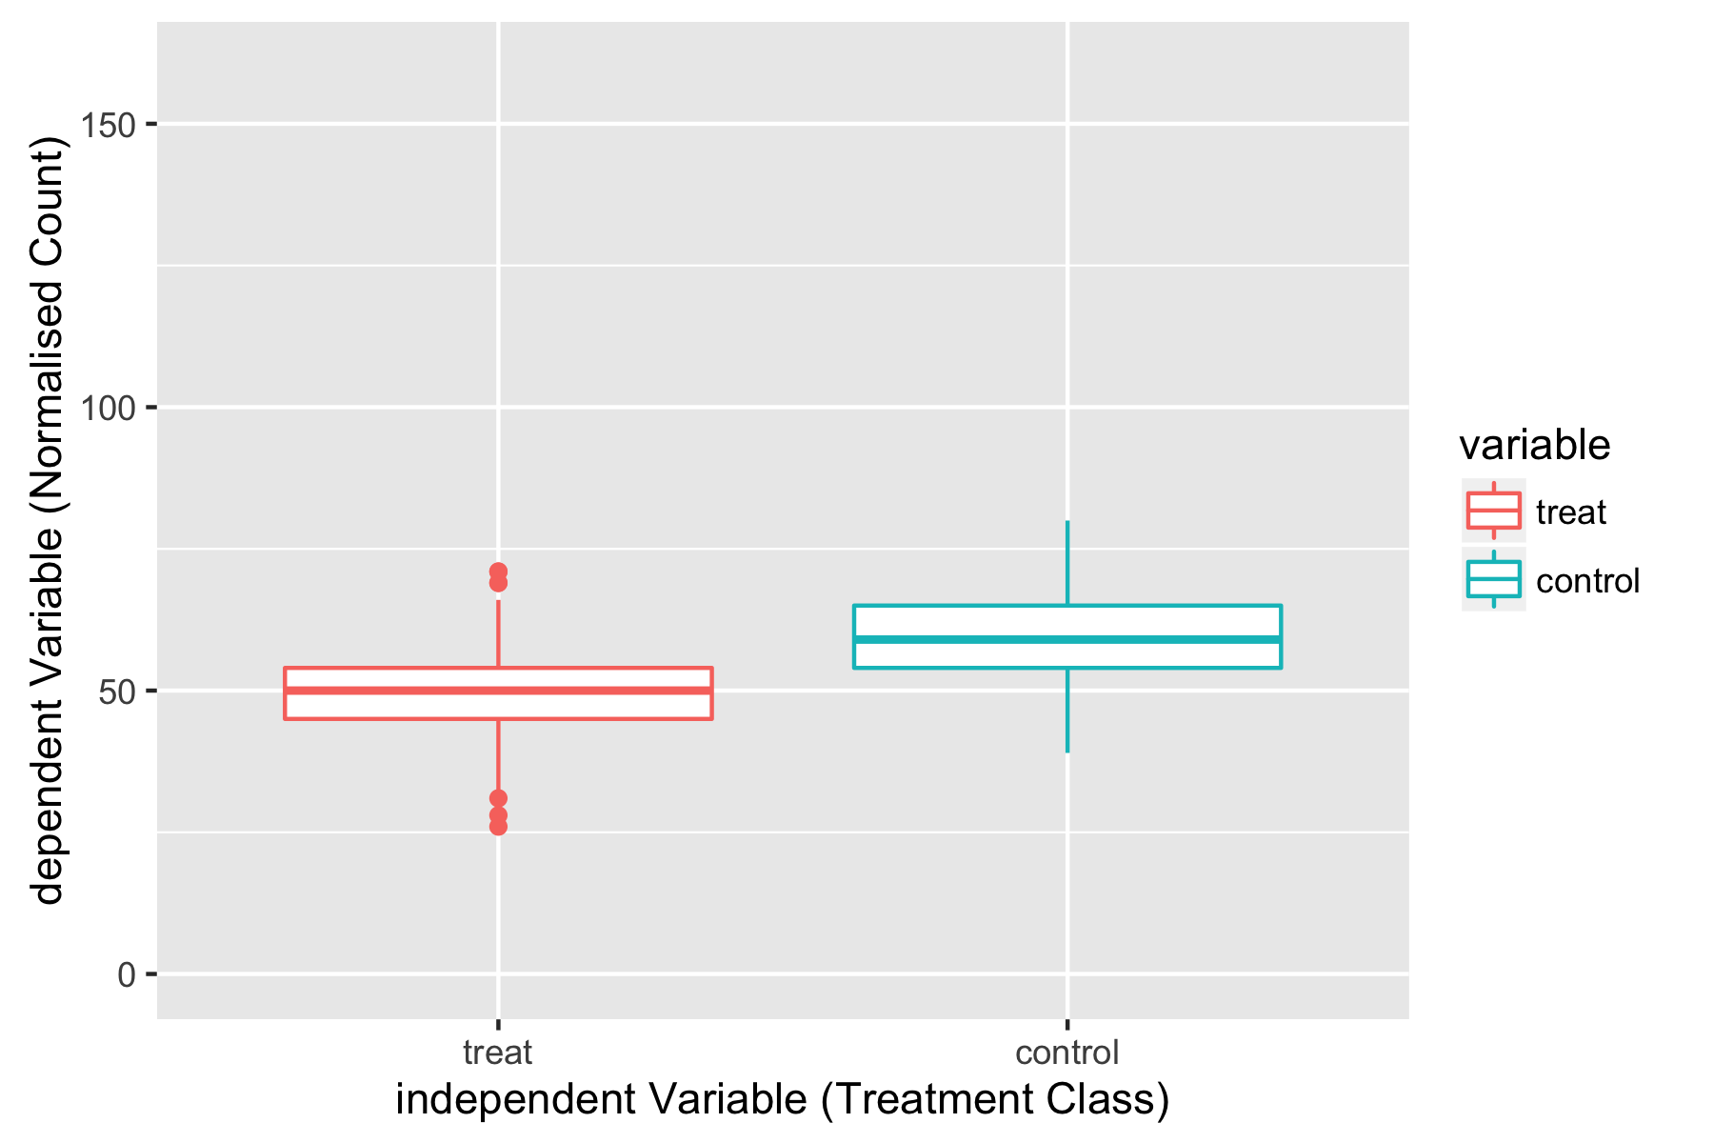
We need Statistics
Notes:
“On average” generally the teated cell has a lower value for the measurement. We are looking at the distribution of possible measurements and comparing them, is some statistic (property of the distribution, for example the mean) of the treated measurement different from the same statistic for the untreated measurent. We turn to statistical tests

Slide 8
Hypothesis Testing
null hypothesis
  there is no difference between the values for the two groups
alternative hypothesis
  there is a difference
p-value
  what is the probability of seeing this data if the null hypothesis (there is no difference) is true
the smaller the p-value the less likely the two groups are the same.
Notes:
Traditionally we turn to hypothesis testing.

Slide 9
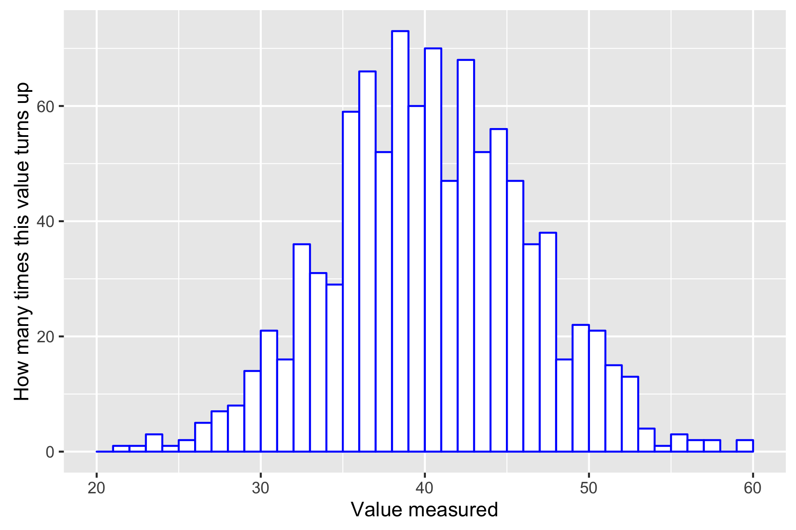
Shape of The Data
Not only the location (central tendency) but the scale (spread) of the data
Notes:
We are looking at distributions. The shape of the possible values of our measurement.

Slide 10
Parametric vs NON-Parametric
Parametric Statistics
  makes an assumption about a mathematical model with parameters that describe the shape or probability distribution of the data
Non-parametric Statistic
  no assumption of a mathematical model for the shape of the data
Both approaches can be used for differential gene expression analysis but we are going to concentrate on a parametric approach.

Slide 11
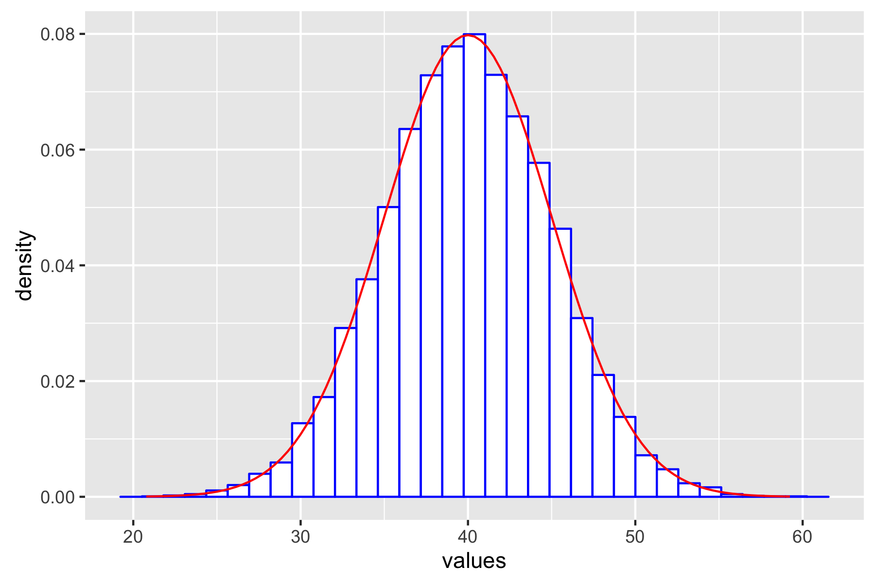
Gaussian (or normal) model
Notes:
If you can come up with a mathematical formula for the shape of the distribution there are values that will determine the shape of the distribution. These are referred to a parameters

Slide 12
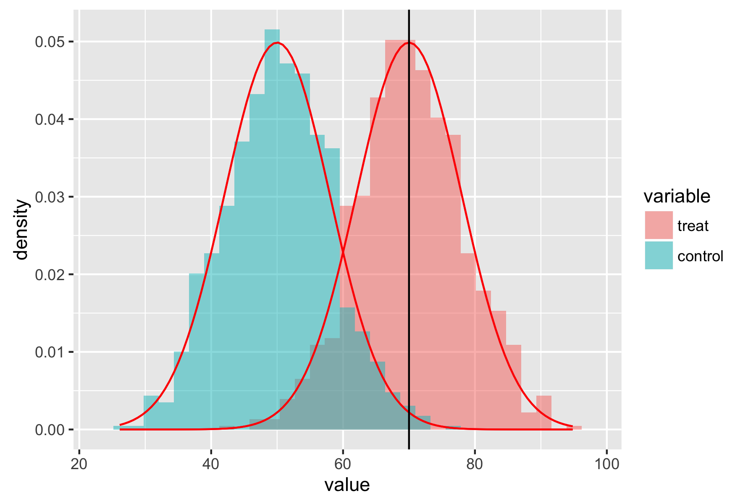
T-Test
Notes:
For example the normal distribution is defined by its mean (central value) and its spread or variance how wide the curve is. The area under the curves where there is overlap represents the probability that

Slide 13
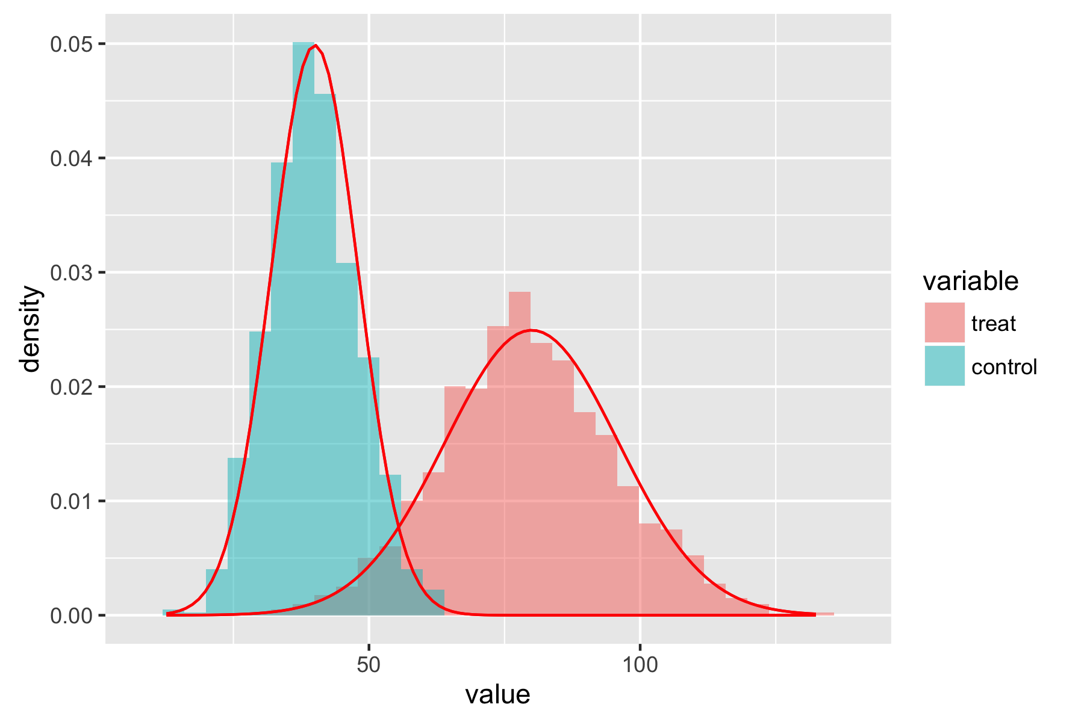
Welsh’s T-Test
Notes:
Certain test for example the t-test require that the data fits one of these parametric distributions well enough that we can calculate the area under a curve and determine how likely a particular value or greater of a measurement is.

Slide 14
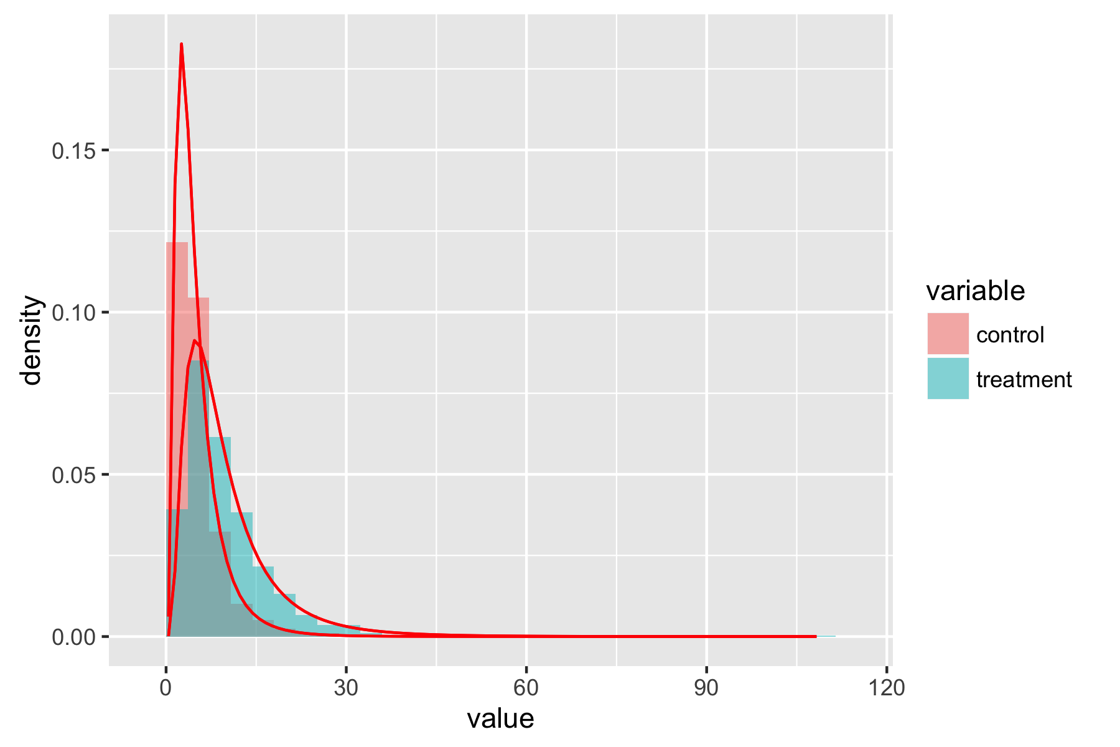
Non-Normal Data
Notes:
If the shape of the data is sufficiently different the calculations will not be valid. We need to find another test that works for the shape of our data.

Slide 15
The Shape of RNA-Seq Data
"The sciences do not try to explain, they hardly even try to interpret, they mainly make models. By a model is meant a mathematical construct which, with the addition of certain verbal interpretations, describes observed phenomena. The justification of such a mathematical construct is solely and precisely that it is expected to work"
John Von Neumann

Slide 16
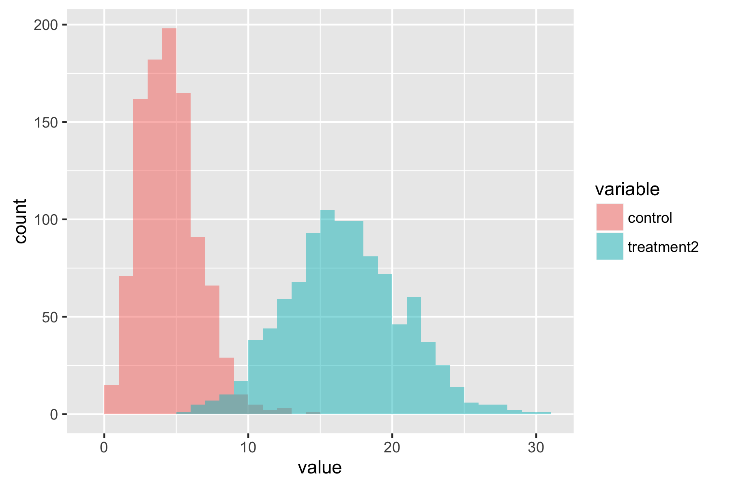
COUNT DATA (POISSON)
Notes:
So what is the shape of RNA-seq data. The counts of reads from fragments of RNA in a sample.

Slide 17
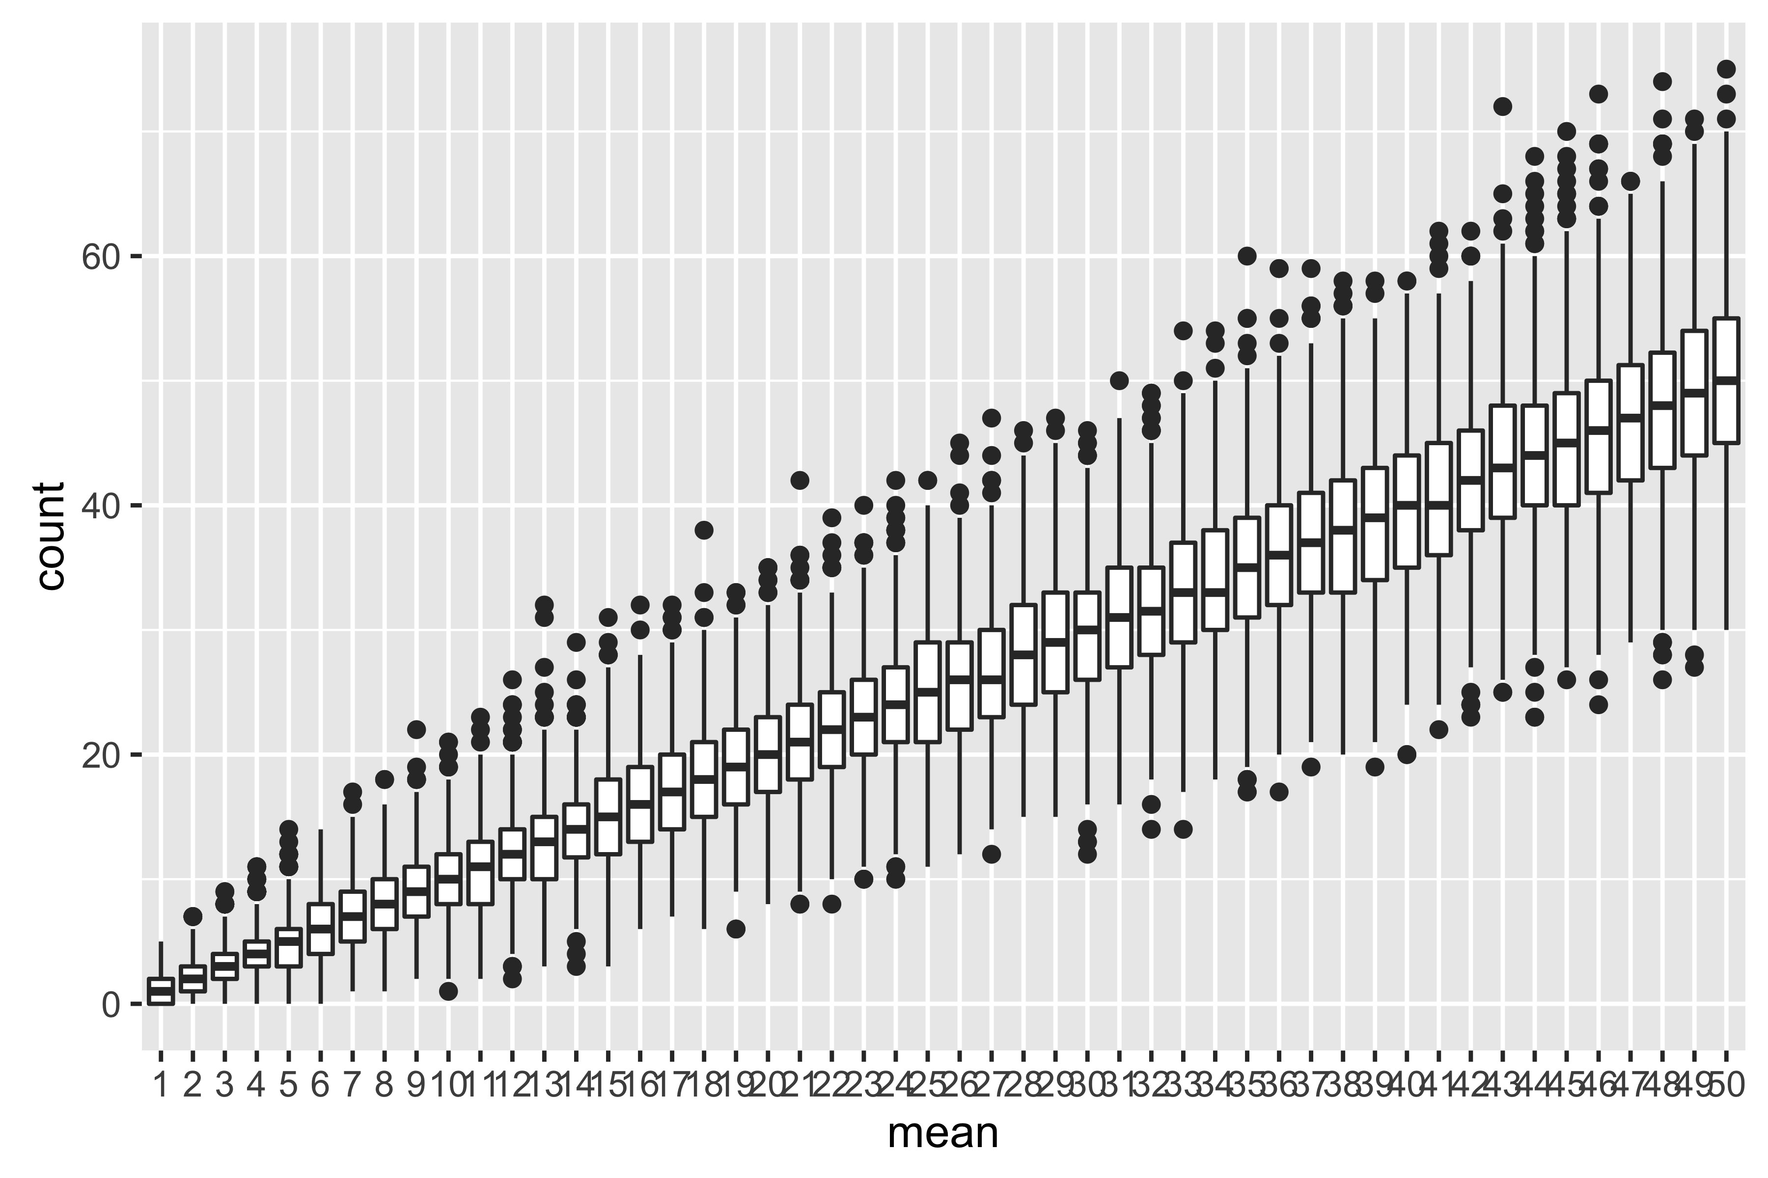
Mean = VARIANCE
Notes:
Most count data is not normal (it cant be negative, or infinitely large) Most count data follows something called the poisson distribution.

Slide 18
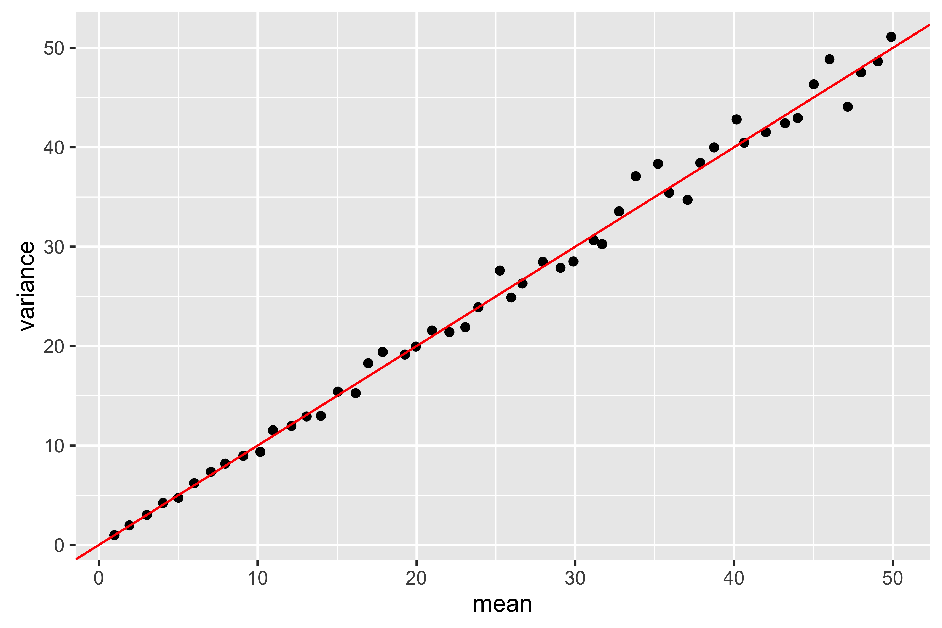
Mean VARIANCE RELATIONSHIP
Notes:
A key thing about the poission distribution is that as the mean value increase so does the spread. The larger the mean number of counts between samples the larger the differences between sample. The poisson has the property that in fact the mean and the variance are equal.

Slide 19
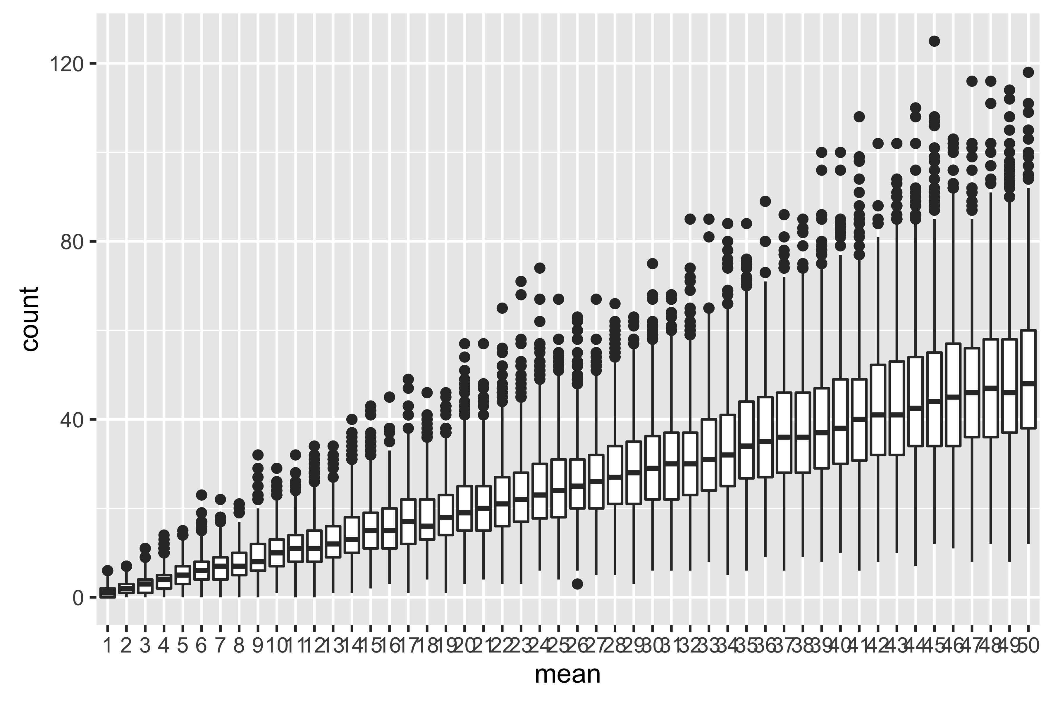
OVERDISPERSION
Notes:
RNA-seq data is slightly different. As the number of counts increases the spread (variance between samples) increases but at a greater rate than the mean

Slide 20
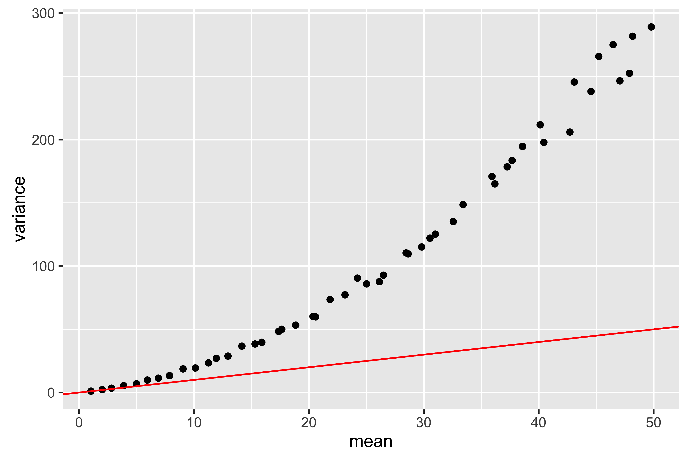
mean Variance Relationship
Notes:
RNA-seq data is what is called Over dispersed.

Slide 21
RNA-seq Data Distribution
is count data
count data is often near poissonian
  technical replicates tend to display Poisson distribution but...
  biological replicates tend to be over-disperse i.e. the variance increase faster than the mean
alternative over-dispersed models
  Poisson mixture
  negative binomial
  beta binomial
transform the data
  log transform
Notes:
Since RNA-seq data is not normal or poisson people have tried several technique to calculate significances for differences between statistics. The have used alternative parametric models, they have tried transforming the data so that it approximates to normal and they have tried using non-parametric methods

Slide 22
LOW replicate data
RNA-seq data is generally low replicate data (<<30) and therefore statistical power is low
use data points from all (or groups of) genes to calculate or model the mean variance relationship (variance shrinkage)
  use empirical Bayes methods to sample the data to estimate variance
  fit models of mean variance relationships to all data to estimate variances for specific individual genes
use robust statistical methods to lessen the impact of outliers such as trimmed or winsorized values
Notes:
Another factor in the analysis of RNA-seq data is that typically folk only have the time and money to produce a small number of samples. This can lead to poor estimates of the variance, highly effected by outliers to get round this various techniques are used for example using the data for all the genes to calculate the variance rather than just the value of an individual gene,

Slide 23
DATA TRANSFORMATIONS
“You can't compare an apple to an orange. It will cause a lot of self-esteem issues.”
Craig Sheffer

Slide 24
“Normalisation”
The term normalisation does not have an exact definition when used in the RNA-seq literature, but broadly it means a transformation of the data that
attempts to ensure comparison of like-with-like.
reduces sources of unwanted variation (not related to the experimental conditions)
It is an essential step, and choice of the factors used to “normalise” over can make a big difference to the result.
Notes:
There will typically be variation you are interested in (biological/treatment effects) and variation you are not really interested in, technical variation, measurement errors.

Slide 25
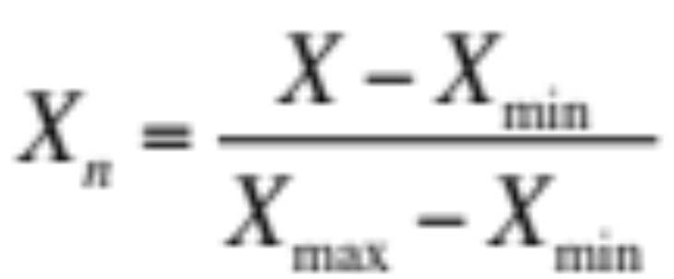
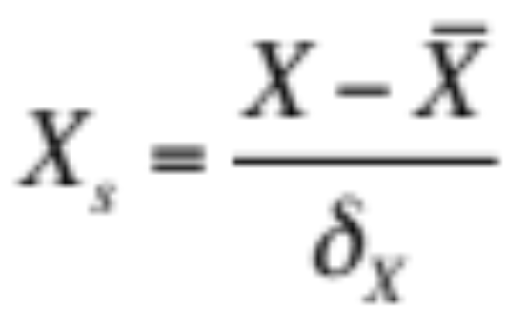
Similar Terms
Normalisation, scales all numeric variables in the range [0,1].
Standardisation transforms data to have zero mean and unit variance

Slide 26
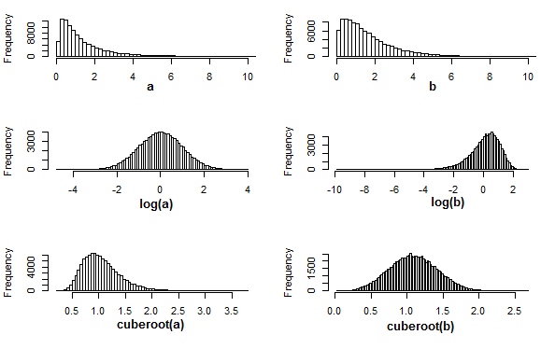
transformation
transformation – transformation is used to convert data that is not gaussian to roughly gaussian to enable the use of t-tests

Slide 27
Library size variation
total number sequence reads will vary between samples for non-biological reasons
Extracted
Library
Sequenced
Extracted
Library
Sequenced
Sample A
Sample B
Notes:
One of the main sources of error is the amount of sequencing produced for a sample will vary, There is an extraction step where variation between samples will occur then the sample is made up to a fixed volume but when the library is run on the sequencing machine there will also be variation between runs over exactly how any reads get sequences.

Slide 28
Gene Length
longer gene can be broken into more different fragments and therefore it is more likely fragments from long genes will be sequenced
  complicated if genes change isoform between treatments
  smaller counts makes significant differential expression harder to detect
Notes:
There is variation between genes not related to expression, longer genes will produce more reads so will produce more sequencing.

Slide 29
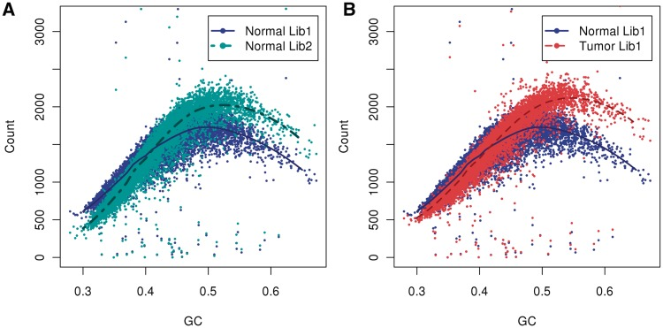
GC content
image Benjamini & Speed 2012 Nucleic Acid Res.
Notes:
It has also been noted that the proportion of GC versus AT nucleotides in an RNA effects how many fragments are sequenced

Slide 30
Total RNA composition
Extracted
Library
Extracted
Library
Sample A
Sample B
Notes:
Another intersting effect that often needs to be accounted for is that since the resources (oligotides and probes) is a finite resource if a gene that is highly expressed in one condition and hence producing lots of fragments and using up lots of resources is not expressed in the other condition all the other genes will get more resource and it may appear they are more highly expressed since they are producing more sequences but it is purely because there is more resource for them not because they are more highly expressed.

Slide 31
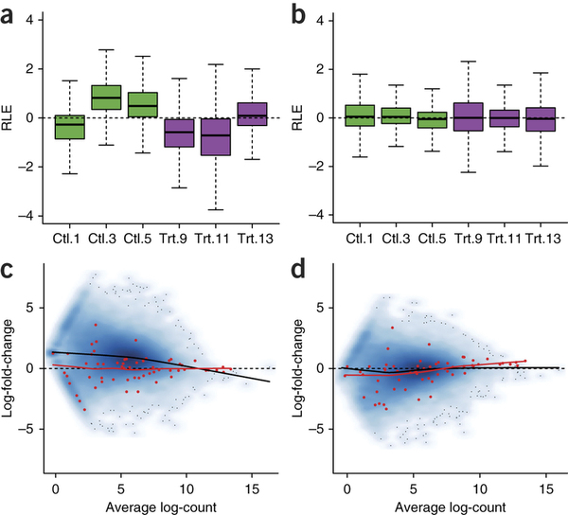
Trimmed Mean of M-Values
Centres the distribution of M-Values (fold changes)
  Most things are not changing significantly
  Roughly as many things go up as do down
Risso et. al. (2014)

Slide 32
Normalisation approaches
Normalisation approaches differ between Tools
How normalisation is applied depends on method
  Pseudo-count (transformed counts) methods scale the counts by normalisation factors and fit the model to the adjusted counts
  Count base methods tend to introduce extra components (offsets) into the model and fit the adjusted model of the raw counts
Which factors to normalise by and what correction method chosen make a bigger difference.
  It is important to understand the assumptions behind the normalisation.

Slide 33
Models
“Essentially, all models are wrong but some are useful”
George Box 1978
"The fact that the polynomial is an approximation does not necessarily detract from its usefulness because all models are approximations. Essentially, all models are wrong, but some are useful. However, the approximate nature of the model must always be borne in mind.”
George Box 1978

Slide 34
RNA-Seq Models
There are a bewildering number of different proposed models for RNA-seq data
Even more bewildering number of implementations as software packages
Each paper claims their method “out performs” the others
  most of these claims based on simulated data
  simulated data require generating model assumption

Slide 35
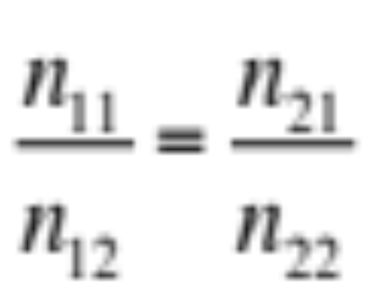
Pairwise Exact Test
tests the null hypothesis that the proportion of counts for gene x in 2 conditions is the same as for the other genes
 | Condition1 | Condition2 | Marginal Totals
Gene X | n₁₁ | n₁₂ | n₁₁ + n₁₂
All other Genes | n₂₁ | n₂₂ | n₂₁ + n₂₂
Marginal Totals | n₁₁ + n₂₁ | n₁₂ + n₂₂
Notes:
One of the simplest ways to test for differential expression if you have two conditions is to use pairwise contingency table test. The assumption is that most genes are not changing. The ratio between normalised counts is close to 1. We can test to see if the ratio for a particular gene the same as the ratio for all the other non-changing genes.

Slide 36
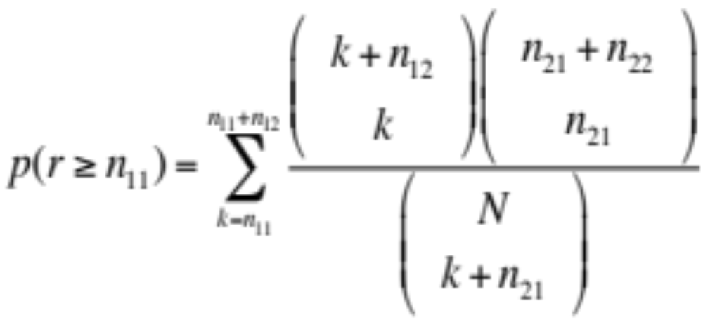
Fisher’s Exact Test
Notes:
The probability used to calculate significance is produced using what is called Fishers Exact Test.

Slide 37
Generalised Linear Models
a group of models which include
  linear models
  general linear models
  multiple regression
  simple linear models
  ANOVA
  logistic regression
  as special cases of GLMs with limiting assumptions
Notes:
An alternative method is to use what are called GLMs

Slide 38
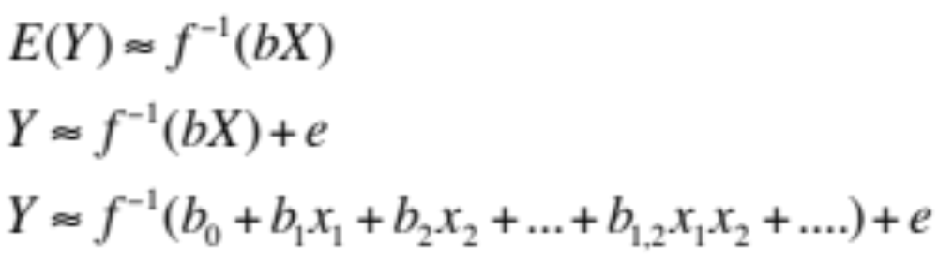
GLMs
probability model for the errors e of the dependent (response) variable
linear predictor bX (linear combination of coefficients for the independent variable terms)
link function f to transform the linear predictor to the dependent variable

Slide 39
Example DATA
 | WT-1 | WT-2 | WT-3 | Mut-1 | Mut-2 | Mut-3
gene1 | r_{1,1} | r_{1,2} | r_{1,3} | r_{1,4} | r_{1,5} | r_{1,6}
gene2 | r_{2,1} | r_{2,2} | r_{2,3} | r_{2,4} | r_{2,5} | r_{2,6}
gene3 | r_{3,1} | r_{3,2} | r_{3,3} | r_{3,4} | r_{3,5} | r_{3,6}
where r_{i,j} is the read count for gene i in the jth sample
Notes:
If you have six sample 3 each from 2 conditions and you have counts for 3 genes

Slide 40
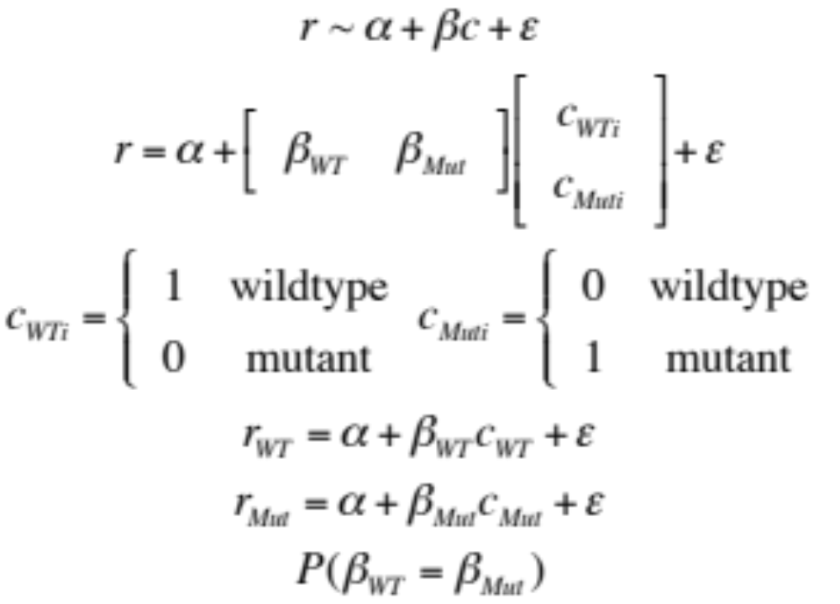
Consider a single gene
Notes:
you can produce a model that says the number r reads is dependent on some constant alpha and an amount beta effected by then condtion and some amount that was uncontrolable variation or error epsilon

Slide 41
Model Fitting
an assumption about the distribution of the error term ε,
can calculate the best fit values for α, β_{WT} and β_{Mut}
can calculate statistic that β_{WT} = β_{Mut}
  or fold change β_{Mut}/β_{WT} = 1 ,
  or log2 fold change log2(β_{Mut}/β_{WT}) = 0
Notes:
We have 6 cases of this equation and we try to work out if beta_wt is different to beta_mut. Is there an effect of condition if we assume that there is no difference in the base line alpha.

Slide 42
Tools differ in
their assumptions about ε
  poisson, negative binomial etc.
the method they use to fit the parameters
the statistical method they use to test for log2(β_{Mut}/β_{WT})=0
generally log2 fold-change agree well between tools but significance values can vary considerably
how complicated your design can be
  extra factors in the model other than just treatment/condition
Notes:
To solve this equation and work out the significance it is important to have a model for the variation in the data. There are many tools for solving GLM’s and they vary over different aspects.

Slide 43
Multiple Test Correction
“Littlewood's law of miracles states that in the course of any normal person's life, miracles happen at the rate of roughly one per month.”
Freeman Dyson (no not the vacuum cleaner man!)

Slide 44
Littlewood’s Law.
we are awake eight hours each day
we see and hear things happening at a rate of one per second.
total number of events that happen to us is about 30,000 per day, or about a million per month.
If a miracle is a “one in a million” event i.e. happens about once in every million events.
Therefore we should expect about one miracle to happen, on the average, every month.
(John Edensor Littlewood)
Notes:
There is a law called littlewoods law that states miracles orrur once a month. It is based on an assumption about how rare an event must be for it to be called a miracle and how many events someone is capable of observing in a week

Slide 45
The multiple comparison problem
as the number of genes compared between two conditions increases, it becomes more likely that the condition being compared will appear to differ in terms of at least one gene just by chance.
if I set 9 H or T out of 10 tosses as indicating a coin is biased, the more coins I toss the greater the chance of getting 9 out of 10 for one of them even though it is not biased
Notes:
This brings us to the problem of chance events when we are looking at so many events. If we use the usual biology p-value of 0.05 and say an event that has a probability of happening of 1 in 20 by pure chance is rare enough that if it occurs we call it significant, but we test 100 things then we actually expect to see 20 chance events and falsely will assume they are important.

Slide 46
Solutions
There are various strategies for reducing this i.e. for controlling the false positives in a set of multiple comparisons
Which strategy to choose can depends on the purpose of the study.
  If preventing getting false positives is important choose a conservative correction
  if preventing getting false negatives is important choose a more permissive correction
If you are on a fishing expedition looking for candidate genes you should control for multiple comparisons
False positives will be noise in your downstream analysis
Notes:
Several methods for reducing the chance of getting false positives exist some are more conservative that others. The important thing is more that you are aware of the problem and if you are looking to see if there is ANYTHING interesting happening in an experiment without a clear idea what that might be, rather than looking to see if something very specific has occurred you really should be controlling for the likelihood of false negatives one way or another. Most tools use something called the Benjamini Hochberg correction.

Slide 47
Visualisations
“The greatest moments are those when you see the result pop up in a graph or in your statistics analysis - that moment you realise you know something no one else does and you get the pleasure of thinking about how to tell them.”
Emily Oster

Slide 48
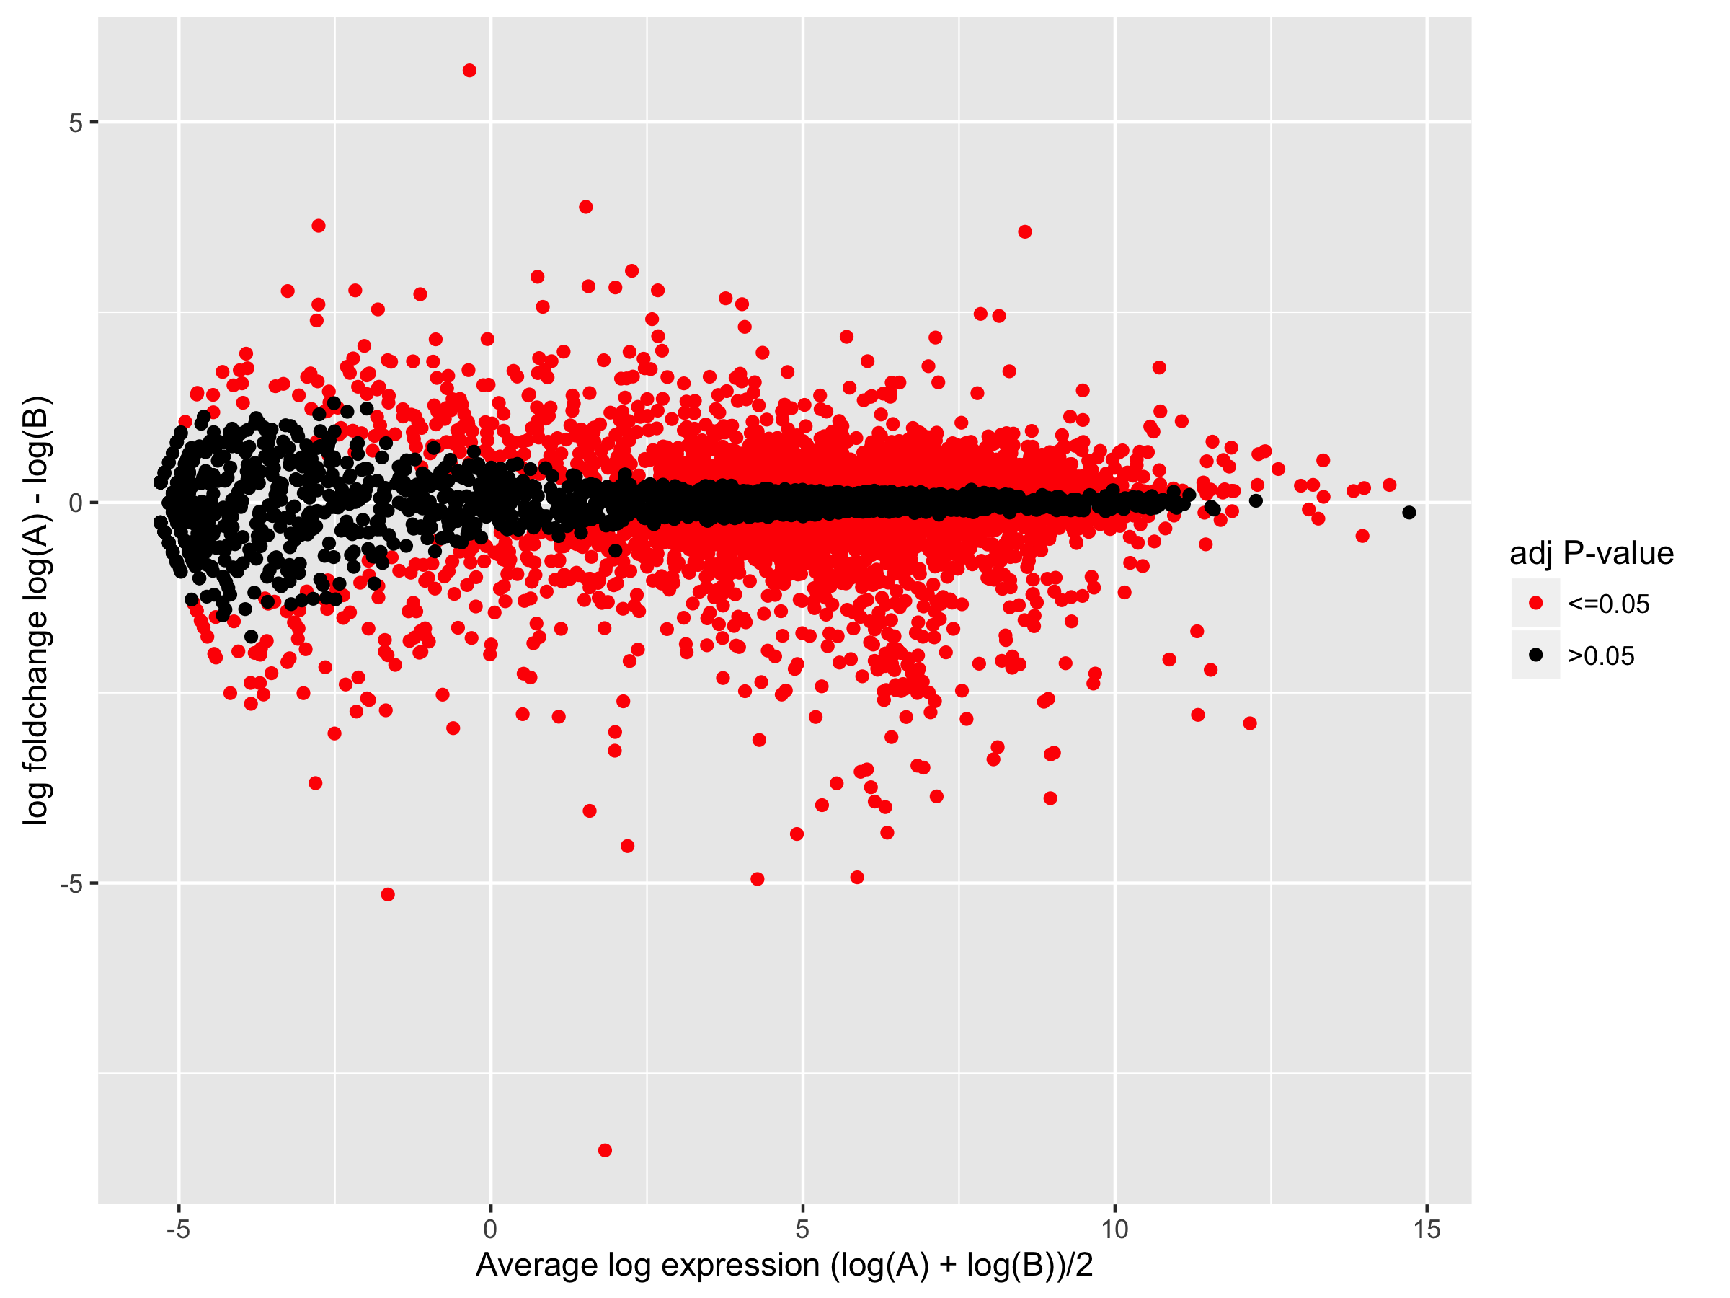
Mean-Difference or MA-PLOT
Notes:
A common plot in differential expression analysis visualisation is the MA plot M is the measure of differential expression (often the log or the ratio the expression in the two conditions) and A is the mean expression of the two conditions.

Slide 49
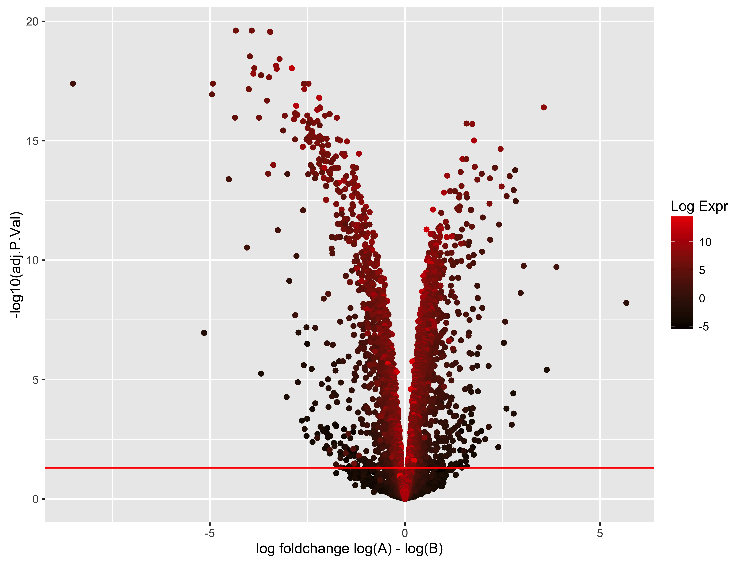
Volcano Plot
Notes:
Volcano plots attempt to plot the fold change (the M value of the MA plot) against the statistical significance value (adjusted p-value or False discovery rate).

